Slide 1
LM Efficiency
CSCI 601-771 (NLP: Self-Supervised Models)
https://self-supervised.cs.jhu.edu/fa2025/

Slide 2
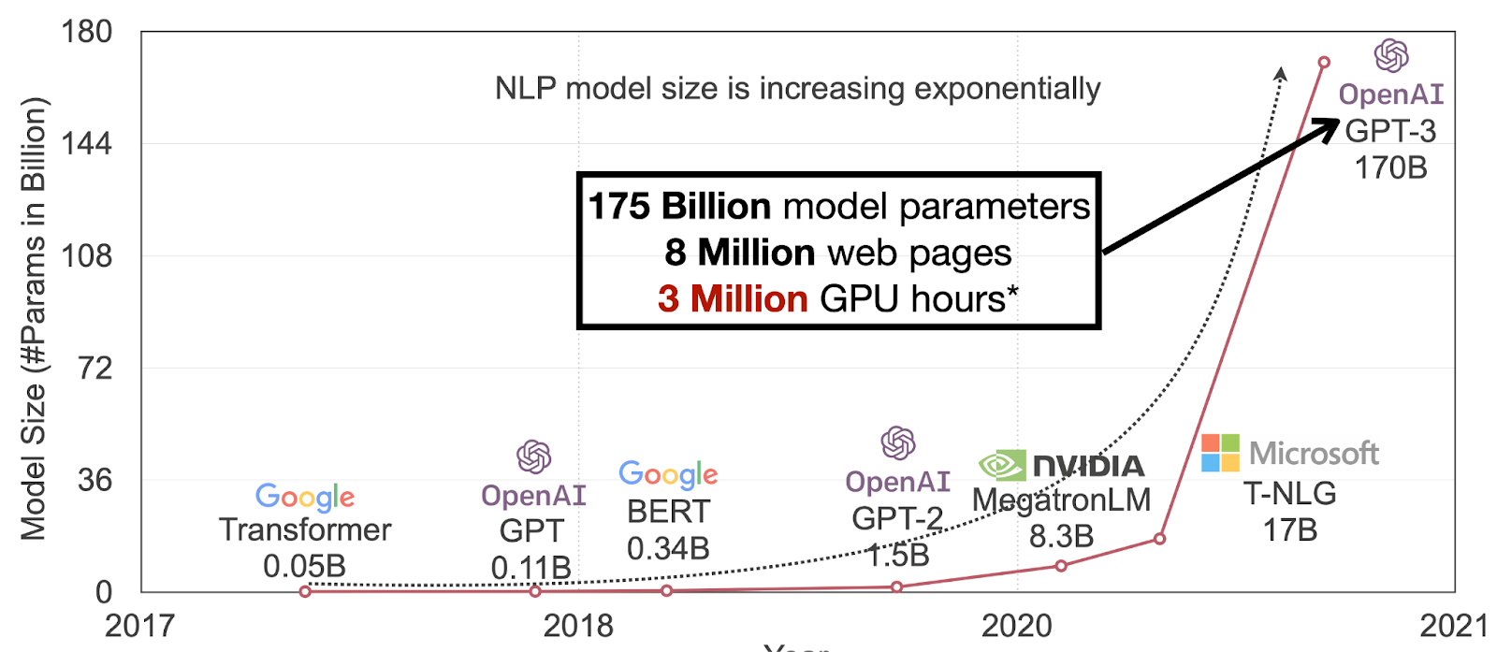
Our models are getting larger!
TBD
Figure Credit: Song Han (MIT)

Slide 3
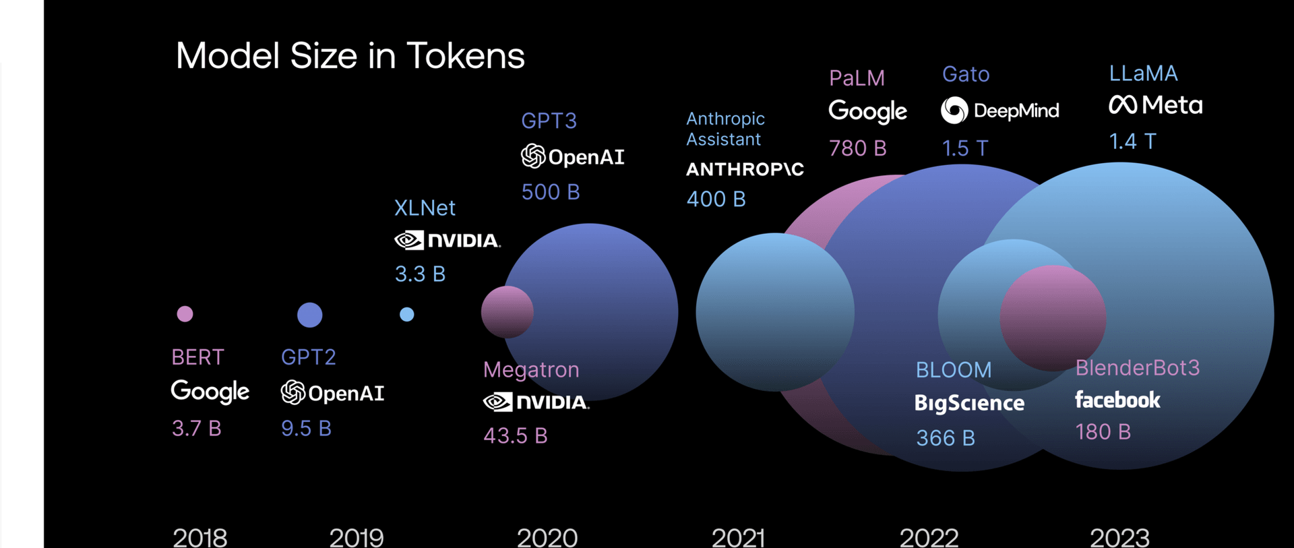
And consumes a lot of data!

Slide 4
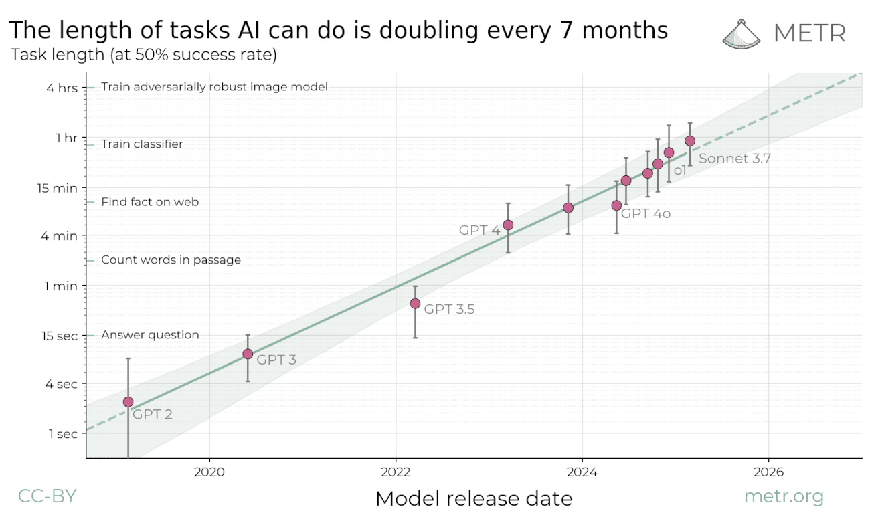
Reasoning models solving long tasks

Slide 5
Compute cost of Transformers

Slide 6
Diversion: Floating-point Ops: FLOPS
Floating point operations per second (FLOPS, flops or flop/s)
Each FLOP can represent an addition, subtraction, multiplication, or division of floating-point numbers,
The total FLOP of a model (e.g., Transformer) provides a basic approximation of computational costs associated with that model.

Slide 7
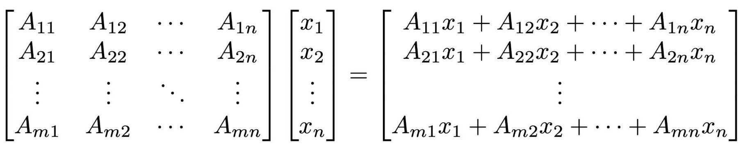
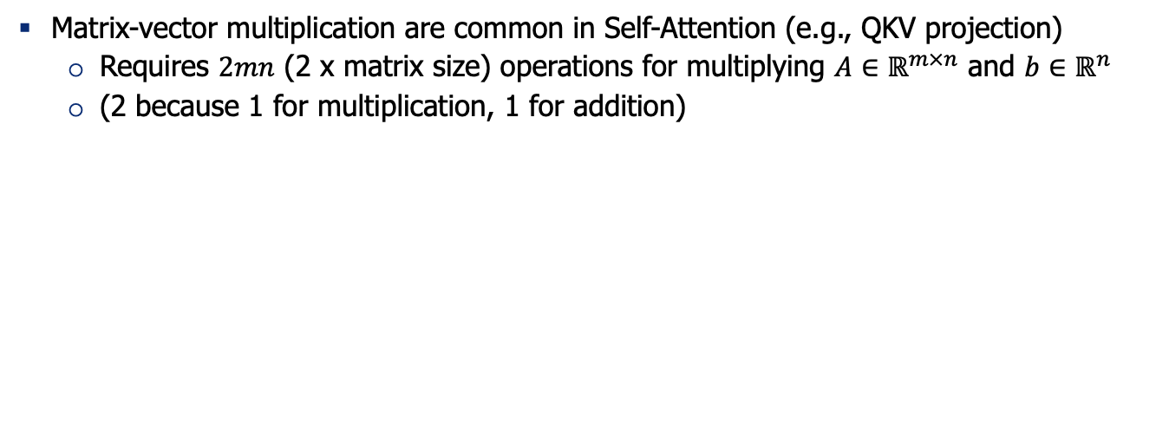
FLOPS of Matrix Multiplication
Matrix-vector multiplication are common in Self-Attention (e.g., QKV projection)
Requires $2mn$ (2 x matrix size) operations for multiplying $A∈ℝ^{m×n}$ and $b∈ℝ^{n}$
(2 because 1 for multiplication, 1 for addition)

Slide 8
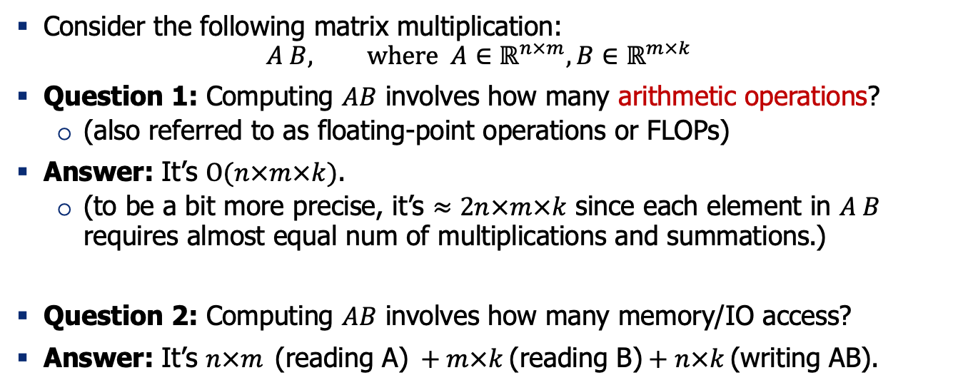
Quiz: thinking about computations
Consider the following matrix multiplication:
$$A B, where A∈ℝ^{n×m},B∈ℝ^{m×k}$$
Question 1: Computing $AB$ involves how many arithmetic operations?
(also referred to as floating-point operations or FLOPs)
Answer: It’s $O(n×m×k)$.
(to be a bit more precise, it’s $≈2n×m×k$ since each element in $A B$ requires almost equal num of multiplications and summations.)
Question 2: Computing $AB$ involves how many memory/IO access?
Answer: It’s $n×m \text{(}\text{reading} \text{A}\text{)} +m×k \text{(}\text{reading} \text{B}\text{)}+n×k \text{(}\text{writing} \text{AB}\text{)}$.

Slide 9
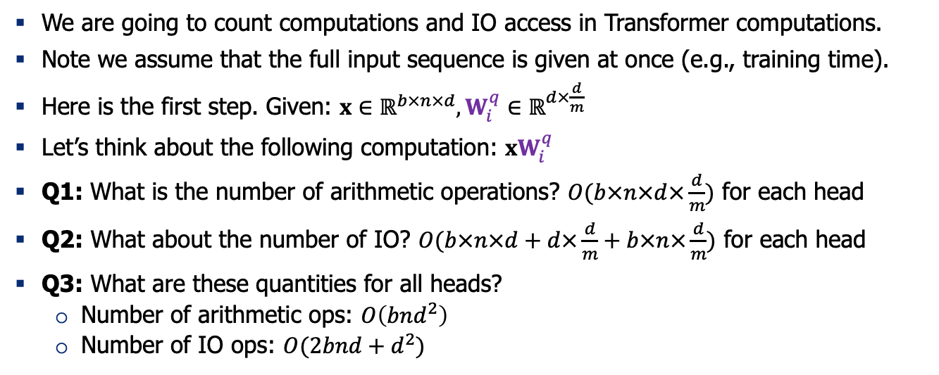
Computations in Self-Attention Block
We are going to count computations and IO access in Transformer computations.
Note we assume that the full input sequence is given at once (e.g., training time).
Here is the first step. Given: $x∈ℝ^{b×n×d},W_{i}^{q}∈ℝ^{d×\frac{d}{m}}$
Let’s think about the following computation: ${xW}_{i}^{q}$
Q1: What is the number of arithmetic operations? $O(b×n×d×\frac{d}{m})$ for each head
Q2: What about the number of IO? $O(b×n×d+d×\frac{d}{m}+b×n×\frac{d}{m})$ for each head
Q3: What are these quantities for all heads?
Number of arithmetic ops: $O\left(bnd^{2}\right)$
Number of IO ops: $O(2bnd+d^{2})$

Slide 10
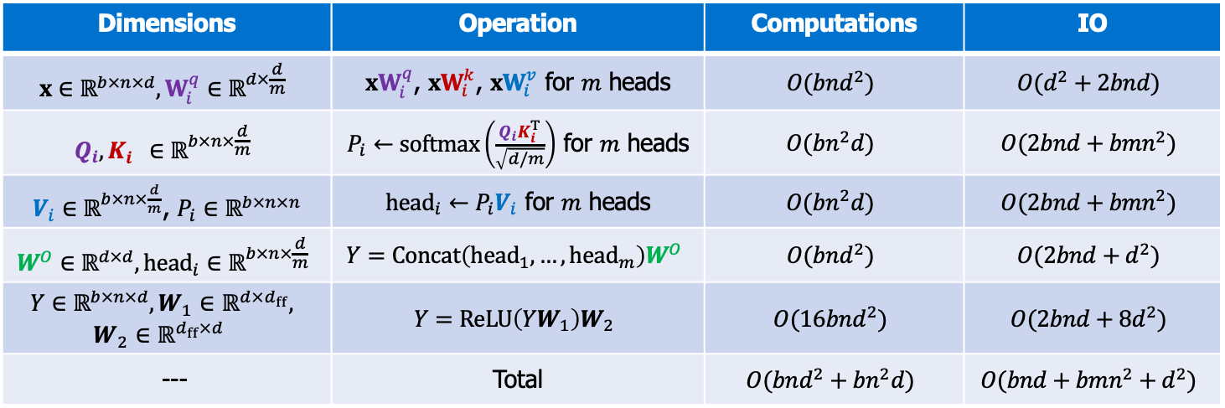
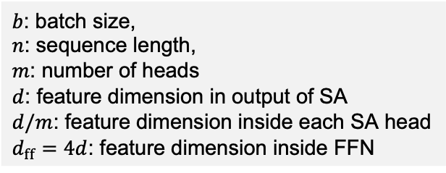
Computations in Self-Attention Block
$b$: batch size,
$n$: sequence length,
$m$: number of heads
$d$: feature dimension in output of SA
$d/m$: feature dimension inside each SA head
$d_{ff}=4d$: feature dimension inside FFN
Dimensions | Operation | Computations | IO
$$x∈ℝ^{b×n×d},W_{i}^{q}∈ℝ^{d×\frac{d}{m}}$$ | ${xW}_{i}^{q}$, ${xW}_{i}^{k}$, ${xW}_{i}^{v}$ for $m$ heads | $$O(bnd^{2})$$ | $$O(d^{2}+2bnd)$$
$$Q_{i},K_{i}^{}∈ℝ^{b×n×\frac{d}{m}}$$ | $P_{i}←softmax\left(\frac{Q_{i}K_{i}^{T}}{\sqrt{d/m}}\right)$ for $m$ heads | $$O(bn^{2}d)$$ | $$O(2bnd+bmn^{2})$$
$V_{i}∈ℝ^{b×n×\frac{d}{m}}$, $P_{i}∈ℝ^{b×n×n}$ | ${head}_{i}←P_{i}V_{i}$ for $m$ heads | $$O(bn^{2}d)$$ | $$O(2bnd+bmn^{2})$$
$$W^{O}∈ℝ^{d×d}, {head}_{i}∈ℝ^{b×n×\frac{d}{m}}$$ | $$Y=Concat\left({head}_{1}, …, {head}_{m}\right)W^{O}$$ | $$O(bnd^{2})$$ | $$O(2bnd+d^{2})$$
$$Y∈ℝ^{b×n×d},W_{1}∈ℝ^{d×d_{ff}},$$ $$W_{2}∈ℝ^{d_{ff}×d}$$ | $$Y=ReLU\left(YW_{1}\right)W_{2}$$ | $$O(16bnd^{2})$$ | $$O(2bnd+8d^{2})$$
--- | Total | $$O(bnd^{2}+bn^{2}d)$$ | $$O(bnd+{bmn^{2}+d}^{2})$$
https://le.qun.ch/en/blog/2023/05/13/transformer-batching/

Slide 11
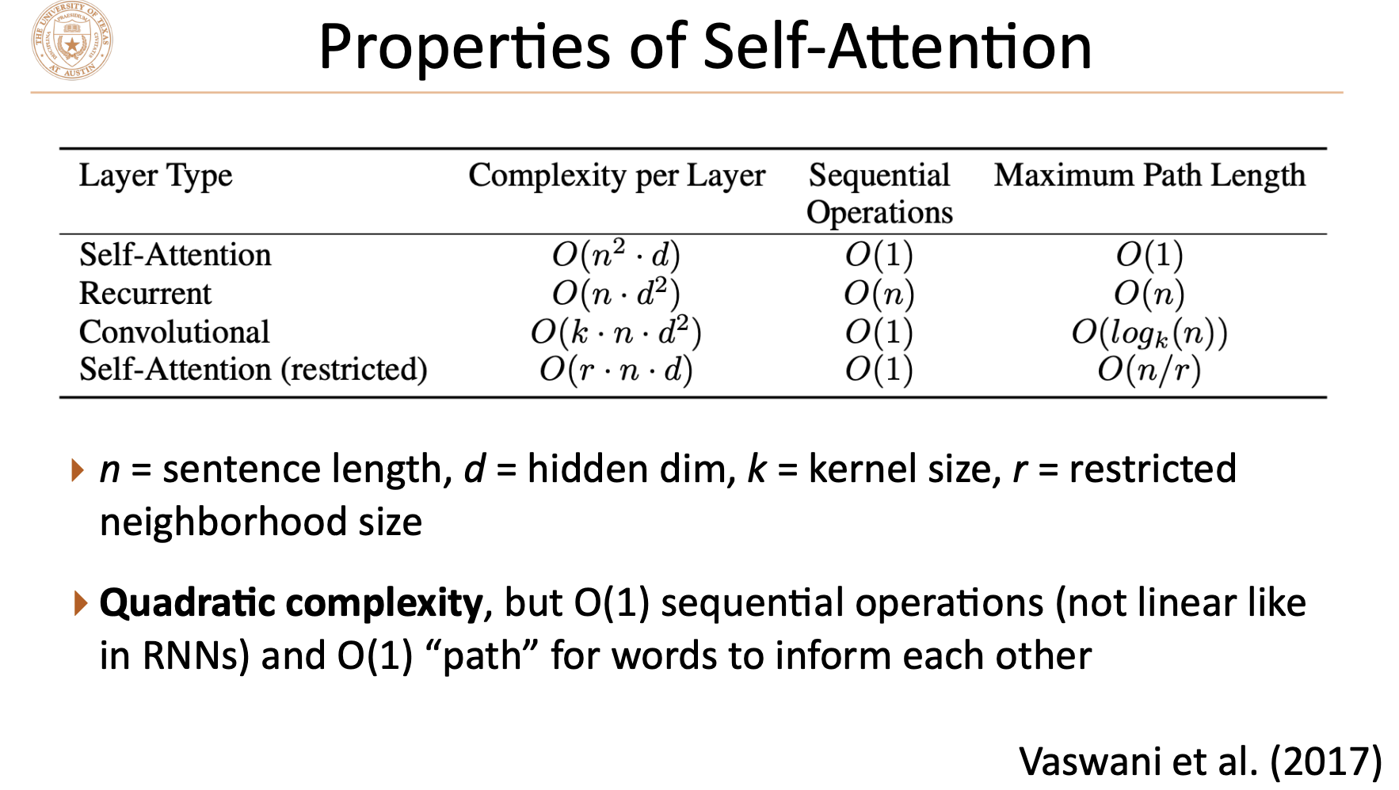
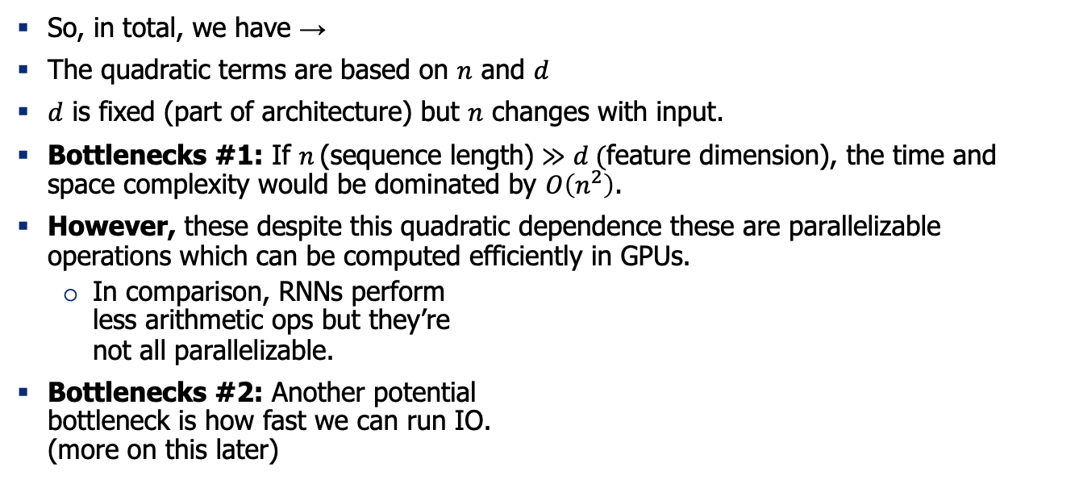
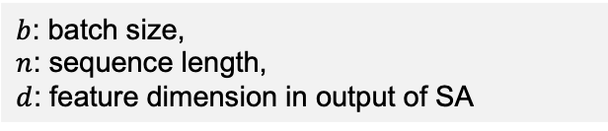
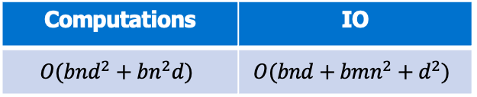
The bottlenecks
$b$: batch size,
$n$: sequence length,
$d$: feature dimension in output of SA
Computations | IO
$$O(bnd^{2}+bn^{2}d)$$ | $$O(bnd+{bmn^{2}+d}^{2})$$
So, in total, we have →
The quadratic terms are based on $n$ and $d$
$d$ is fixed (part of architecture) but $n$ changes with input.
Bottlenecks #1: If $n \text{(}\text{sequence} \text{length}\text{)}≫d (\text{feature} \text{dimension}$), the time and space complexity would be dominated by $O\left(n^{2}\right)$.
However, these despite this quadratic dependence these are parallelizable operations which can be computed efficiently in GPUs.
In comparison, RNNs perform less arithmetic ops but they’re not all parallelizable.
Bottlenecks #2: Another potential bottleneck is how fast we can run IO. (more on this later)
[Vaswani et al. 2017]
Notes:
Let’s then look at where the complexity come from. Recall the attention function …, where dim of q = dimk = Ndk. Calculation of QKt would thus cost O(N^2dk). As for the space complexity, storing the attention matrix which is this (draw) part, cost O(N2) space complexity as well, for each head. Therefore, if we have very long sequences, much longer and dk and h, the time and space cost would be quadratic to sequence length, which would be very terrible if the sequence is very long. This would have a bad impact on the scalability of the transformer, and greatly increase its resource consumption. This would also affect its adoption to all sorts of situation, such as image completion and audio recognition and so.

Slide 12
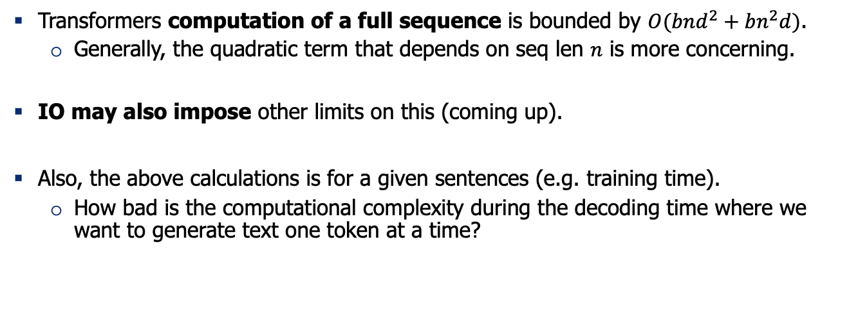
Recap
Transformers computation of a full sequence is bounded by $O(bnd^{2}+bn^{2}d)$.
Generally, the quadratic term that depends on seq len $n$ is more concerning.
IO may also impose other limits on this (coming up).
Also, the above calculations is for a given sentences (e.g. training time).
How bad is the computational complexity during the decoding time where we want to generate text one token at a time?

Slide 13
During decoding time, how slow is attention computation?

Slide 14
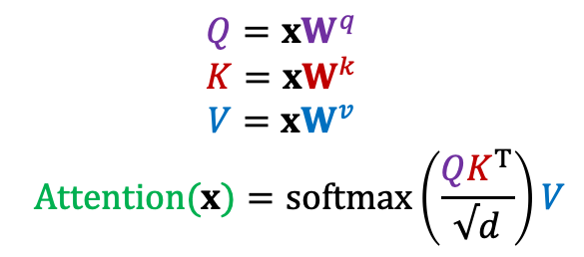
Q: Pulse Check: What is a KV-Cache?
$$Q={xW}^{q}$$
$$K={xW}^{k}$$
$$V={xW}^{v}$$
$$Attention(x)=softmax\left(\frac{{QK}^{T}}{√d}\right)V$$

Slide 15

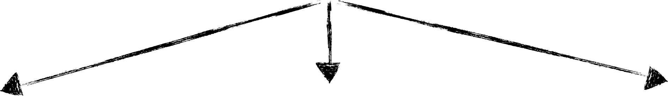



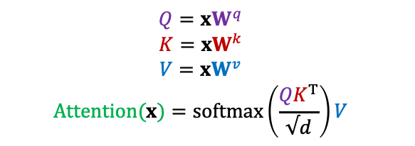
Self-Attention During Inference
$$Q={xW}^{q}$$
$$K={xW}^{k}$$
$$V={xW}^{v}$$
$$Attention(x)=softmax\left(\frac{{QK}^{T}}{√d}\right)V$$
x
q
V
K
[Slide credit: Arman Cohan]

Slide 16
Self-Attention During Inference
$$Q={xW}^{q}$$
$$K={xW}^{k}$$
$$V={xW}^{v}$$
$$Attention(x)=softmax\left(\frac{{QK}^{T}}{√d}\right)V$$
x
q
q: the next token
V
K
previous context
[Slide credit: Arman Cohan]

Slide 17
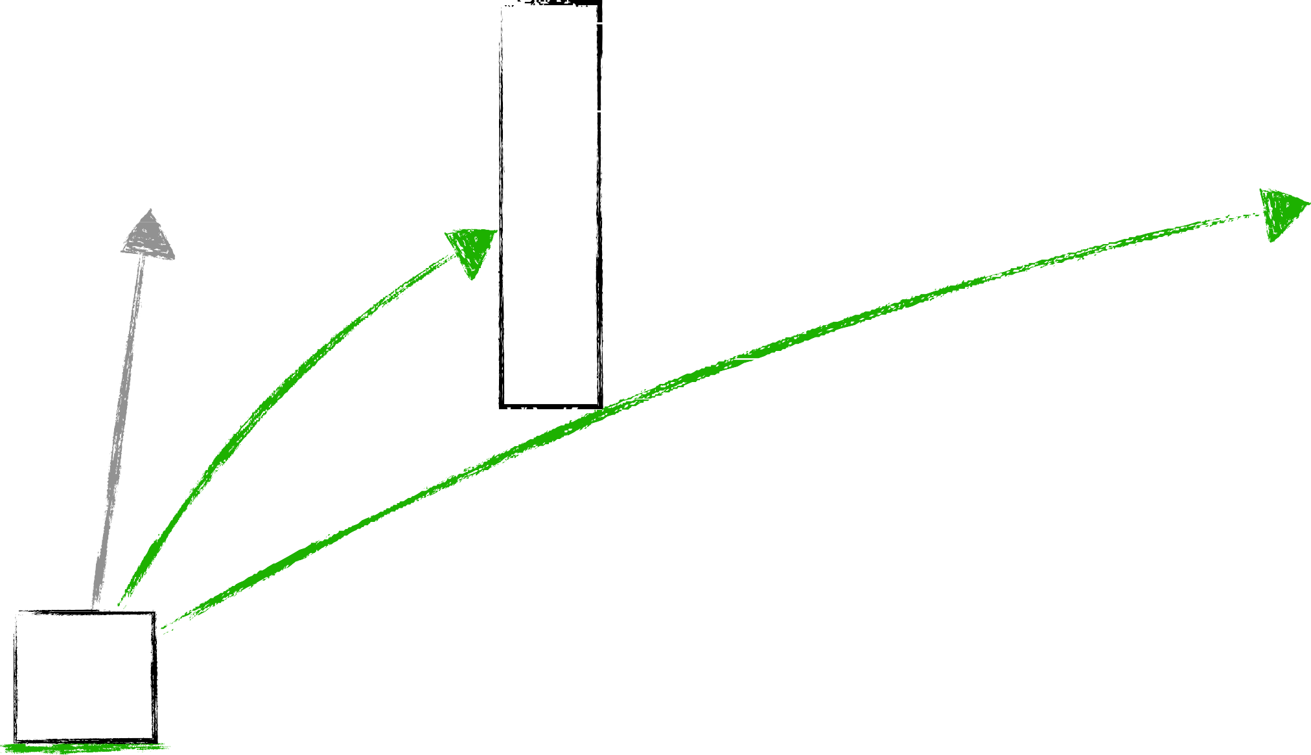

Self-Attention During Inference
$$Q={xW}^{q}$$
$$K={xW}^{k}$$
$$V={xW}^{v}$$
$$Attention(x)=softmax\left(\frac{{QK}^{T}}{√d}\right)V$$
q
K = W_{k}x
V = W_{v}x
q: the next token
previous context
The cat sat on the
[Slide credit: Arman Cohan]

Slide 18
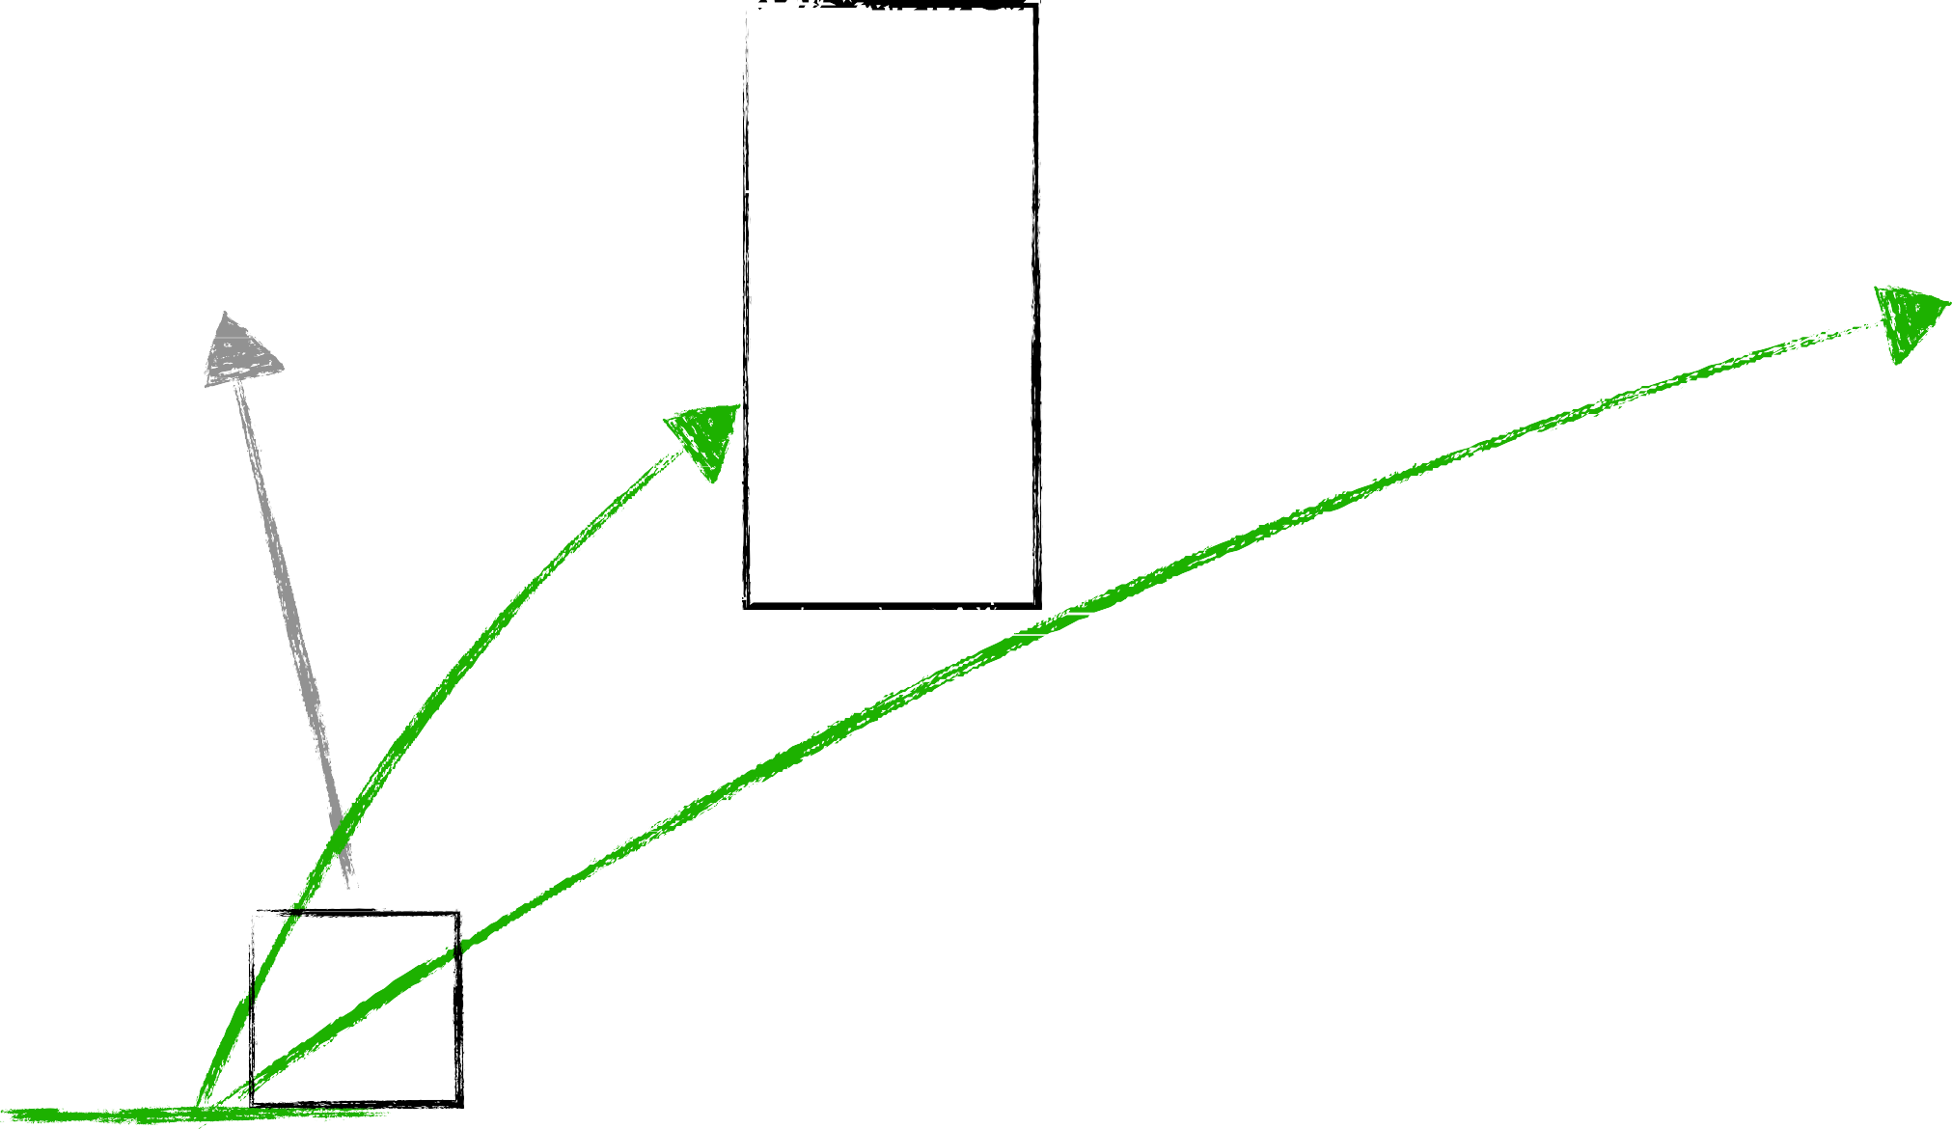

Self-Attention During Inference
$$Q={xW}^{q}$$
$$K={xW}^{k}$$
$$V={xW}^{v}$$
$$Attention(x)=softmax\left(\frac{{QK}^{T}}{√d}\right)V$$
q
K = W_{k}x
V = W_{v}x
q: the next token
previous context
The cat sat on the
[Slide credit: Arman Cohan]

Slide 19
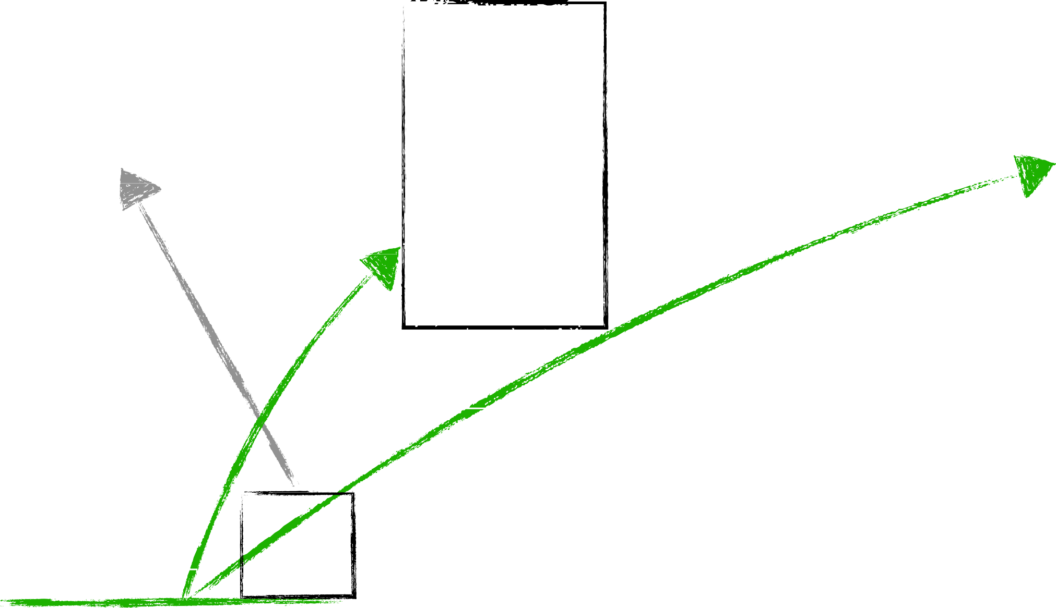

Self-Attention During Inference
$$Q={xW}^{q}$$
$$K={xW}^{k}$$
$$V={xW}^{v}$$
$$Attention(x)=softmax\left(\frac{{QK}^{T}}{√d}\right)V$$
q
K = W_{k}x
V = W_{v}x
q: the next token
previous context
The cat sat on the
[Slide credit: Arman Cohan]

Slide 20
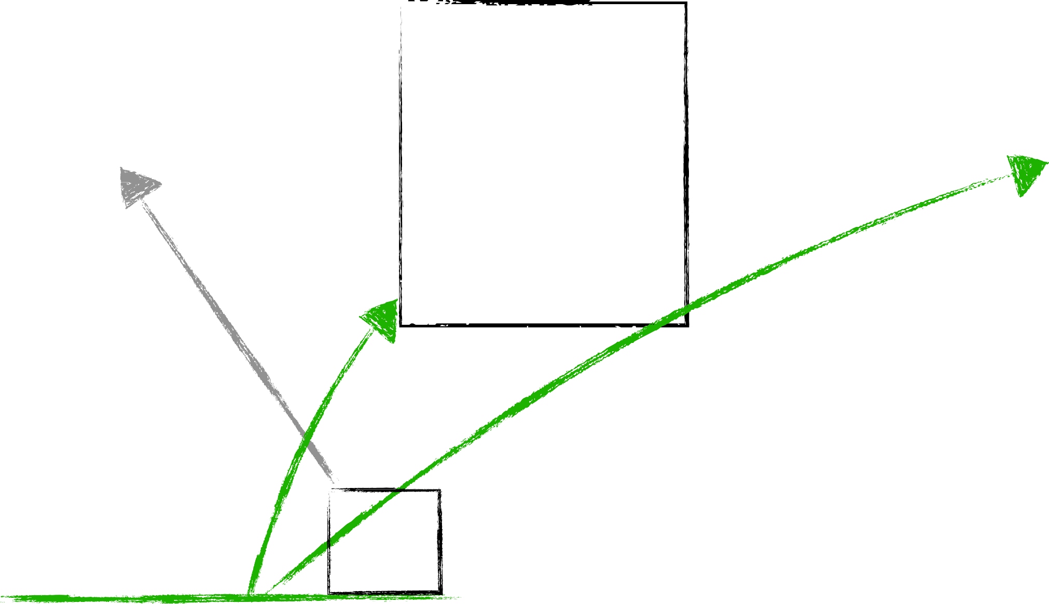
Self-Attention During Inference
$$Q={xW}^{q}$$
$$K={xW}^{k}$$
$$V={xW}^{v}$$
$$Attention(x)=softmax\left(\frac{{QK}^{T}}{√d}\right)V$$
q
K = W_{k}x
V = W_{v}x
q: the next token
previous context
The cat sat on the
[Slide credit: Arman Cohan]

Slide 21
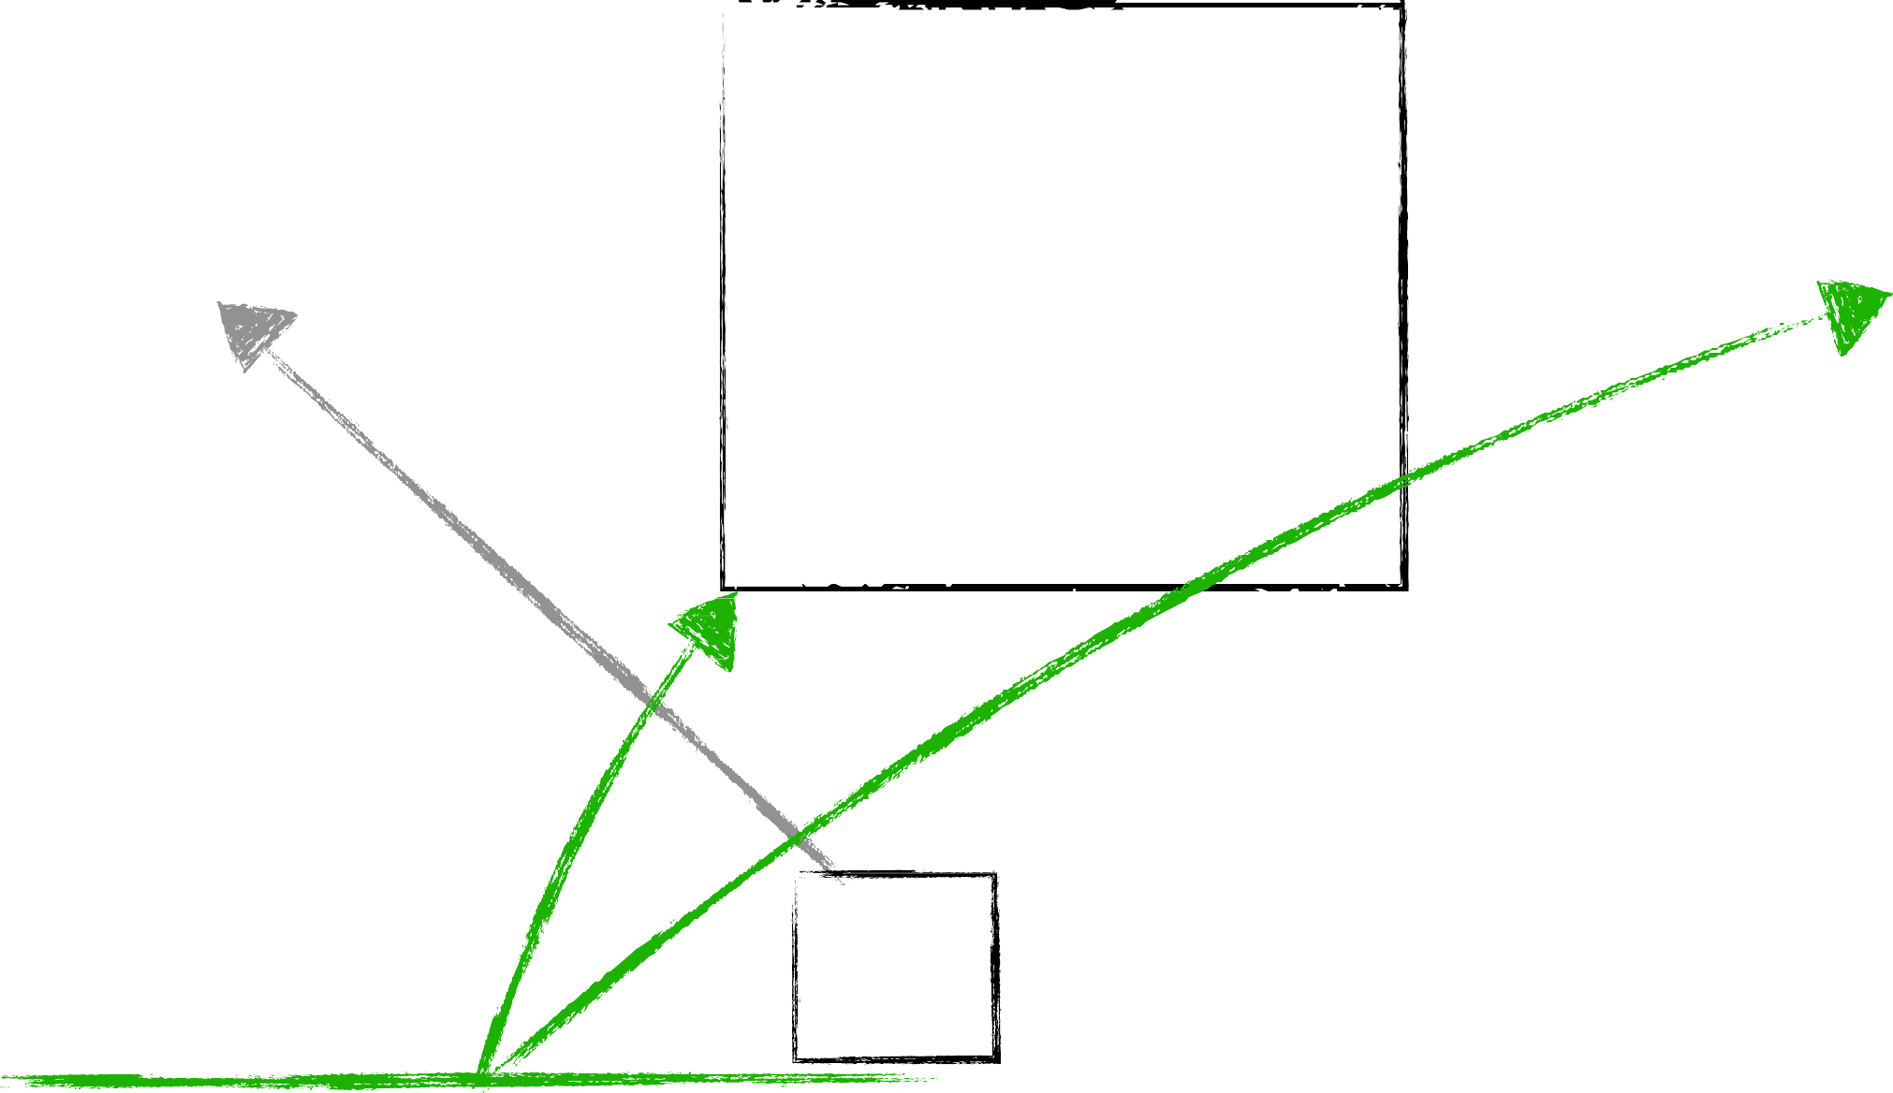

Self-Attention During Inference
$$Q={xW}^{q}$$
$$K={xW}^{k}$$
$$V={xW}^{v}$$
$$Attention(x)=softmax\left(\frac{{QK}^{T}}{√d}\right)V$$
We are computing the Keys and Values many times!
Let’s reduce redundancy! 😤
q
K = W_{k}x
V = W_{v}x
q: the next token
previous context
The cat sat on the
[Slide credit: Arman Cohan]

Slide 22
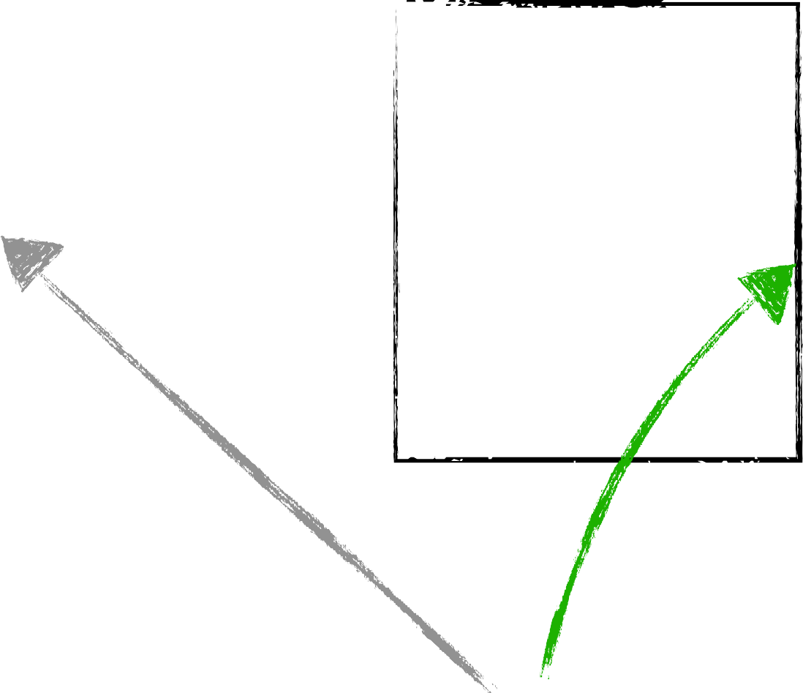


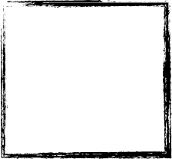
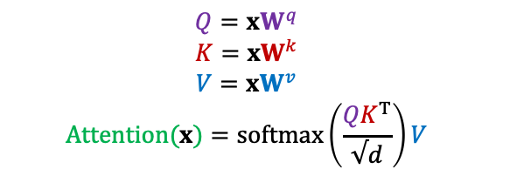
KV-Cache for reducing inference redundancy
$$Q={xW}^{q}$$
$$K={xW}^{k}$$
$$V={xW}^{v}$$
$$Attention(x)=softmax\left(\frac{{QK}^{T}}{√d}\right)V$$
We are computing the Keys and Values many times!
Let’s reduce redundancy! 😤
k_{new} = W_{k}x[: , : − 1]
q
q: the next token
V Cached
K Cached
previous context
v_{new} = W_{v}x[: , : − 1]
The cat sat on the
[Slide credit: Arman Cohan]

Slide 23
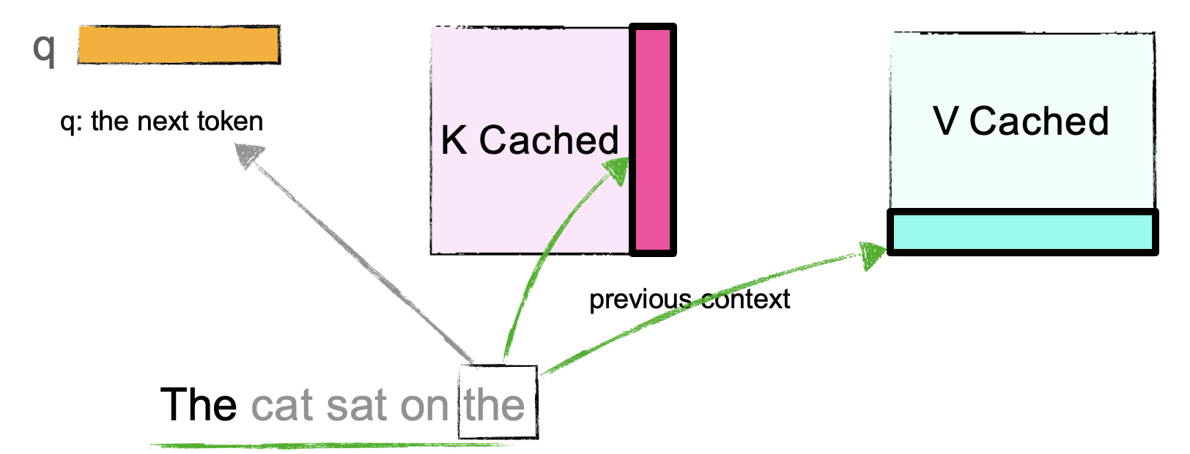
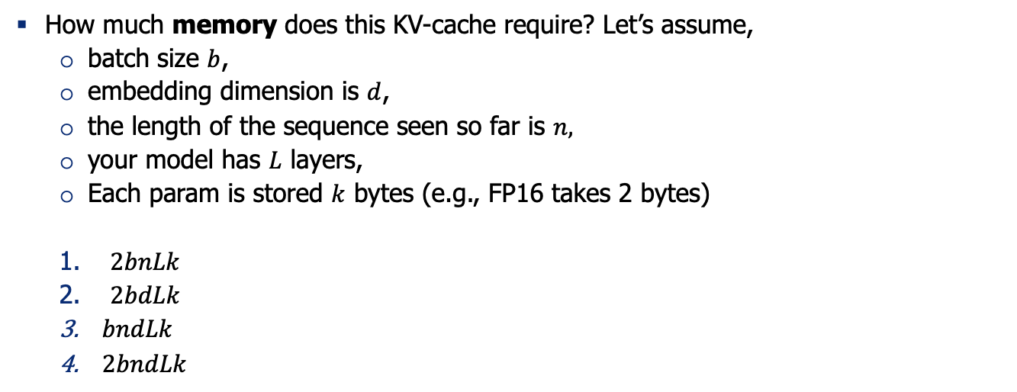
Quiz: KV-Cache
How much memory does this KV-cache require? Let’s assume,
batch size $b$,
embedding dimension is $d$,
the length of the sequence seen so far is $n,$
your model has $L$ layers,
Each param is stored $k$ bytes (e.g., FP16 takes 2 bytes)
$2bnLk$
$2bdLk$
$bndLk$
$2bndLk$

Slide 24
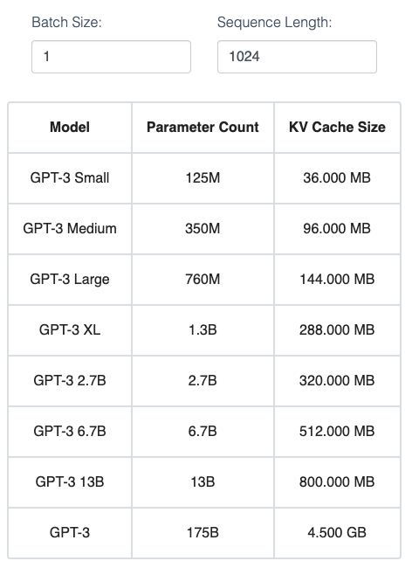
KV-Cache size
For GPT2, this comes out to a modest size of ~36 MB assuming we use the max sequence length of 1024 tokens and a batch size of 1.
For larger models, however, the KV Cache can take up GBs of memory.
Try this calculator

Slide 25
Q: Where do we store the KV Cache?
Depends.
If you’re doing single-GPU inference, it sits on the GPU that computes attention.
KV cache can be offloaded to CPU (RAM) (if GPU is running out of space) but adds latency.
Later we will revisit this discussion after seeing distributed training/inference.

Slide 26
Who has played w/ KV-Cache in practice?

Slide 27
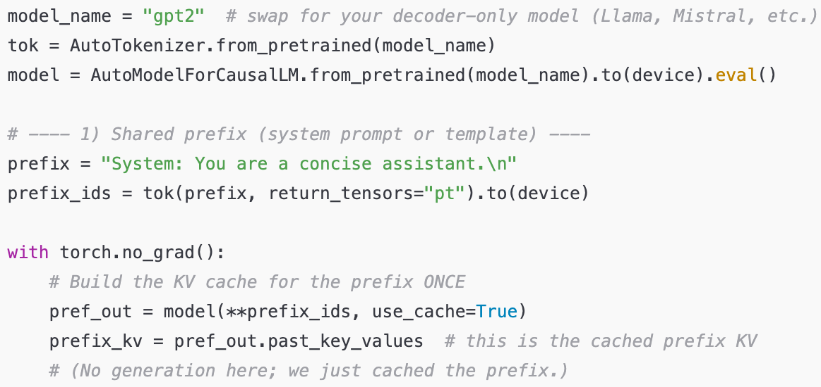
KV-Cache in practice

Slide 28
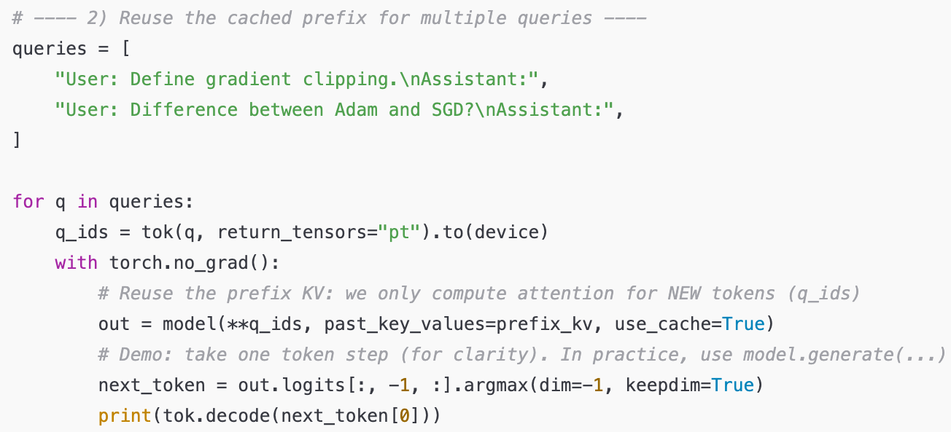
KV-Cache in practice
Note, here we don’t need to re-feed the prefix tokens (prefix_ids) to the model. Why?

Slide 29
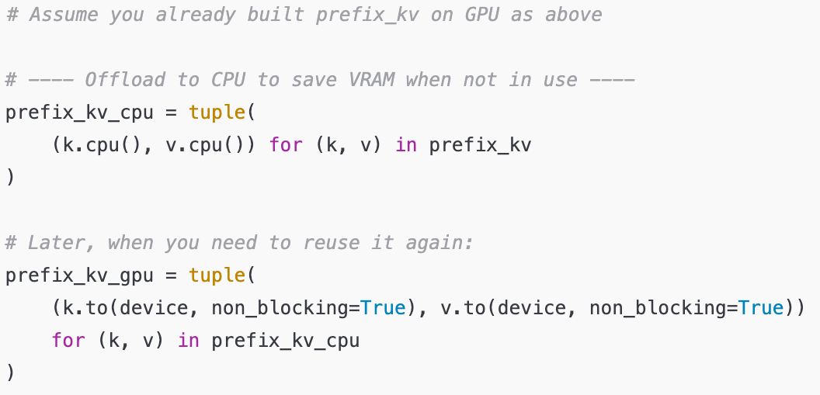
KV-Cache in practice

Slide 30
Recap
To avoid redundant computations during decoding time, KV-cache is used to keep track of previous calculations of keys and values.
But how exactly how costly are these computations?

Slide 31
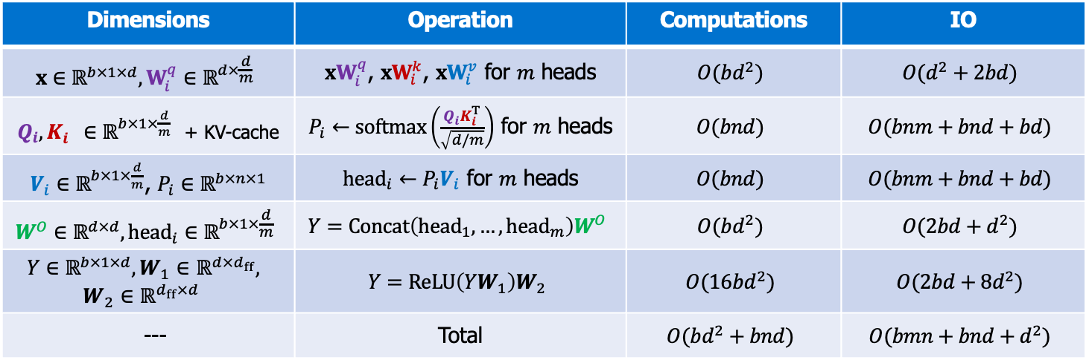
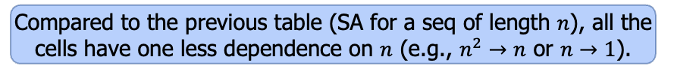
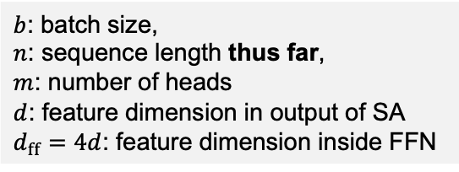
Decoding Computations
$b$: batch size,
$n$: sequence length thus far,
$m$: number of heads
$d$: feature dimension in output of SA
$d_{ff}=4d$: feature dimension inside FFN
Compared to the previous table (SA for a seq of length $n$), all the cells have one less dependence on $n$ (e.g., $n^{2}→n$ or $n→1$).
Notice we’re doing this computations for one token
Dimensions | Operation | Computations | IO
$$x∈ℝ^{b×1×d},W_{i}^{q}∈ℝ^{d×\frac{d}{m}}$$ | ${xW}_{i}^{q}$, ${xW}_{i}^{k}$, ${xW}_{i}^{v}$ for $m$ heads | $$O(bd^{2})$$ | $$O(d^{2}+2bd)$$
$Q_{i},K_{i}^{}∈ℝ^{b×1×\frac{d}{m}}$ + KV-cache | $P_{i}←softmax\left(\frac{Q_{i}K_{i}^{T}}{\sqrt{d/m}}\right)$ for $m$ heads | $$O(bnd)$$ | $$O(bnm+bnd+bd)$$
$V_{i}∈ℝ^{b×1×\frac{d}{m}}$, $P_{i}∈ℝ^{b×n×1}$ | ${head}_{i}←P_{i}V_{i}$ for $m$ heads | $$O(bnd)$$ | $$O(bnm+bnd+bd)$$
$$W^{O}∈ℝ^{d×d}, {head}_{i}∈ℝ^{b×1×\frac{d}{m}}$$ | $$Y=Concat\left({head}_{1}, …, {head}_{m}\right)W^{O}$$ | $$O(bd^{2})$$ | $$O(2bd+d^{2})$$
$$Y∈ℝ^{b×1×d},W_{1}∈ℝ^{d×d_{ff}},$$ $$W_{2}∈ℝ^{d_{ff}×d}$$ | $$Y=ReLU\left(YW_{1}\right)W_{2}$$ | $$O(16bd^{2})$$ | $$O(2bd+8d^{2})$$
--- | Total | $$O(bd^{2}+bnd)$$ | $$O(bmn+{bnd+d}^{2})$$
Query/key computations get combined with KV-cache
Now the computations (of next token) has linear dependence on seq length.
https://le.qun.ch/en/blog/2023/05/13/transformer-batching/

Slide 32
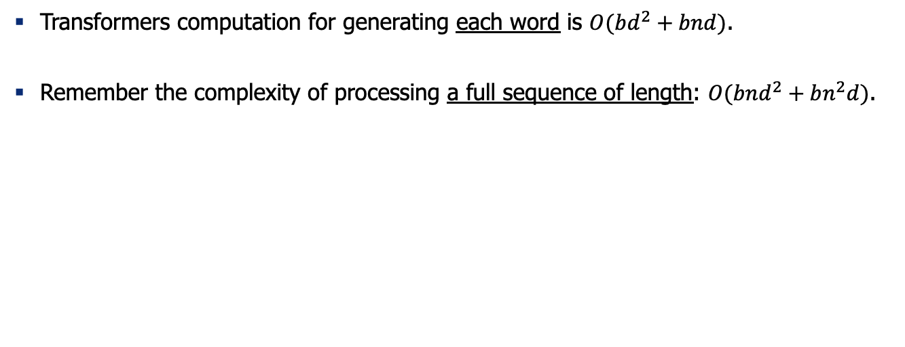
Recap: complexity of decoding text
Transformers computation for generating each word is $O(bd^{2}+bnd)$.
Remember the complexity of processing a full sequence of length: $O(bnd^{2}+bn^{2}d)$.

Slide 33
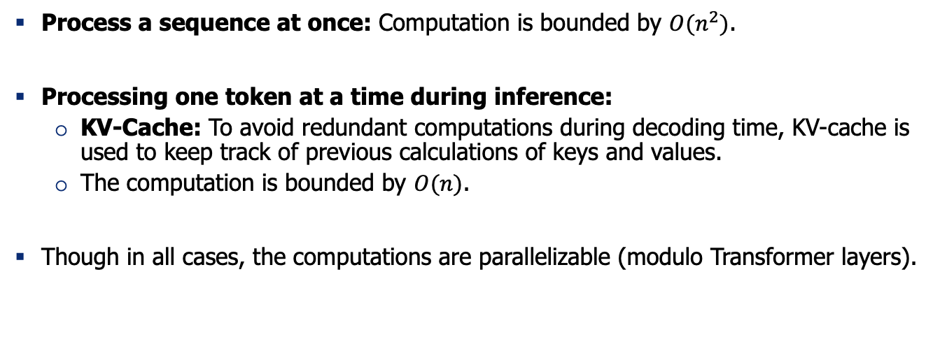
Summary: Computational Complexity of Transformers
Process a sequence at once: Computation is bounded by $O(n^{2})$.
Processing one token at a time during inference:
KV-Cache: To avoid redundant computations during decoding time, KV-cache is used to keep track of previous calculations of keys and values.
The computation is bounded by $O(n)$.
Though in all cases, the computations are parallelizable (modulo Transformer layers).

Slide 34
Thinking about compute vs IO tension

Slide 35
Diversion: Arithmetic Intensity
Arithmetic Intensity of a program execution:
(# of floating-point operations) / (# of data bytes transferred to memory)
It helps determine whether a program is compute-bound or memory-bound:
If AI is high, performance is limited by how fast the GPU can compute.
If AI is low, performance is constrained by how fast data can be transferred between global memory and GPU cores.
A good rule of thumb:
Memory-bound: AI < 10 FLOPs/byte
Balanced: 10 ≤ AI ≤ 100 FLOPs/byte
Compute-bound: AI > 100 FLOPs/byte

Slide 36
Quiz
If a model has high arithmetic intensity, which of the following is true?
A) Performance is mostly limited by memory bandwidth
B) Performance is mostly limited by compute throughput
C) Memory accesses dominate execution time
D) The workload is not well-suited for GPUs
Answer: High AI means the GPU spends more time computing per byte of memory fetched, making it compute-bound rather than memory-bound. Hence, B.

Slide 37
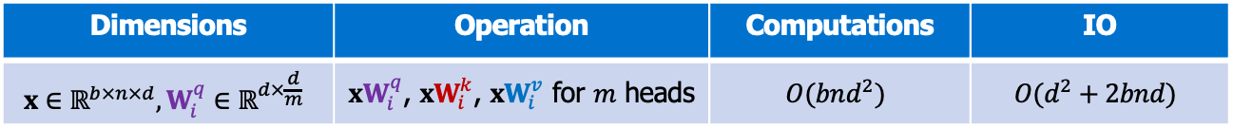
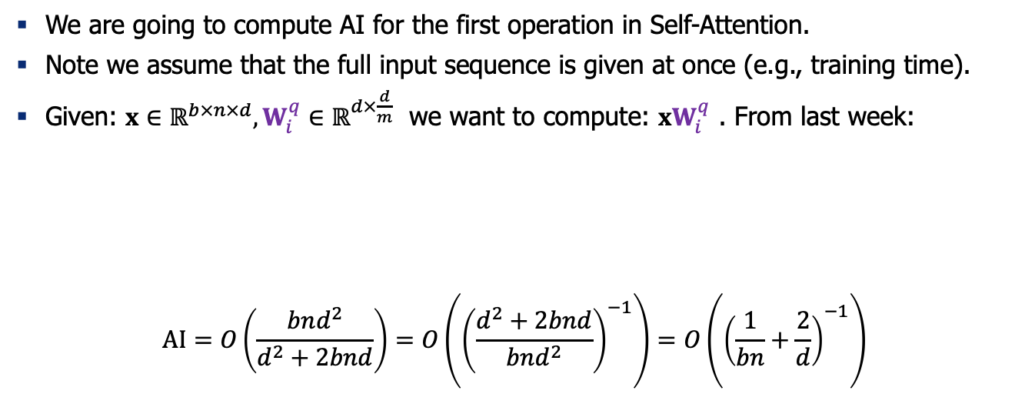
Arithmetic Intensity: An example
We are going to compute AI for the first operation in Self-Attention.
Note we assume that the full input sequence is given at once (e.g., training time).
Given: $x∈ℝ^{b×n×d},W_{i}^{q}∈ℝ^{d×\frac{d}{m}}$ we want to compute: ${xW}_{i}^{q}$ . From last week:
$$AI=O\left(\frac{bnd^{2}}{d^{2}+2bnd}\right)=O\left({\left(\frac{d^{2}+2bnd}{bnd^{2}}\right)}^{−1}\right)=O\left({\left(\frac{1}{bn}+\frac{2}{d}\right)}^{−1}\right)$$
Dimensions | Operation | Computations | IO
$$x∈ℝ^{b×n×d},W_{i}^{q}∈ℝ^{d×\frac{d}{m}}$$ | ${xW}_{i}^{q}$, ${xW}_{i}^{k}$, ${xW}_{i}^{v}$ for $m$ heads | $$O(bnd^{2})$$ | $$O(d^{2}+2bnd)$$

Slide 38
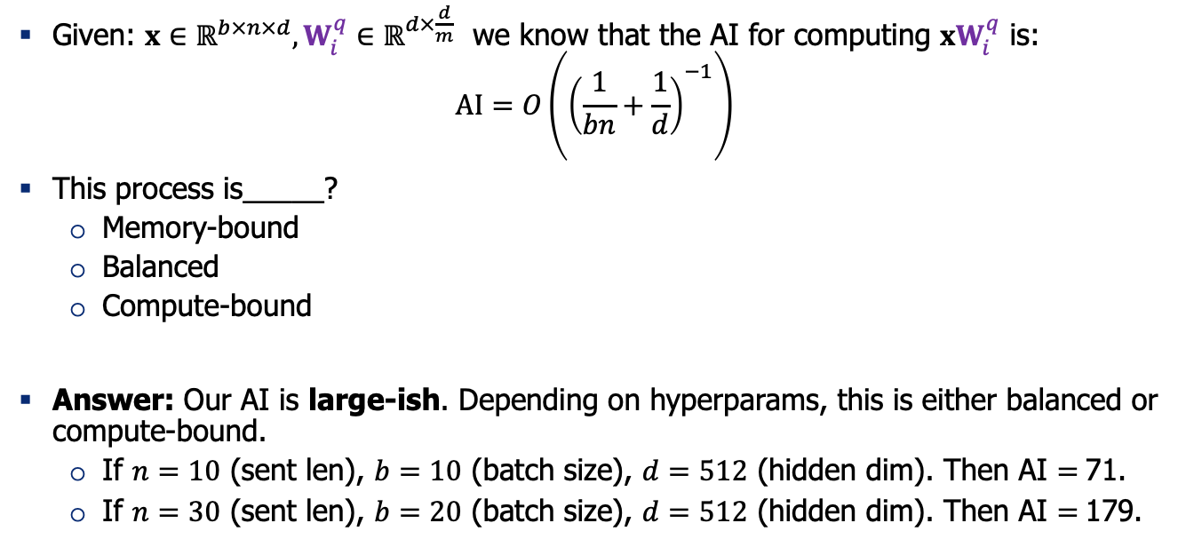
Quiz
Given: $x∈ℝ^{b×n×d},W_{i}^{q}∈ℝ^{d×\frac{d}{m}}$ we know that the AI for computing ${xW}_{i}^{q}$ is:
$$AI=O\left({\left(\frac{1}{bn}+\frac{1}{d}\right)}^{−1}\right)$$
This process is_____?
Memory-bound
Balanced
Compute-bound
Answer: Our AI is large-ish. Depending on hyperparams, this is either balanced or compute-bound.
If $n=10$ (sent len), $b=10$ (batch size), $d=512$ (hidden dim). Then AI $=$71.
If $n=30$ (sent len), $b=20$ (batch size), $d=512$ (hidden dim). Then AI $=$179.

Slide 39
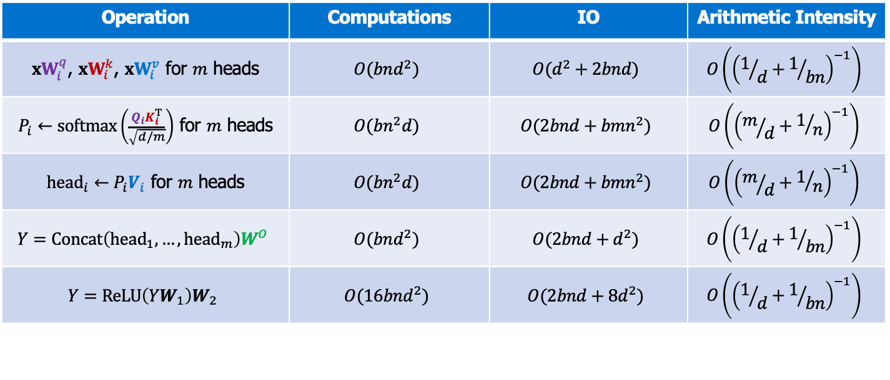
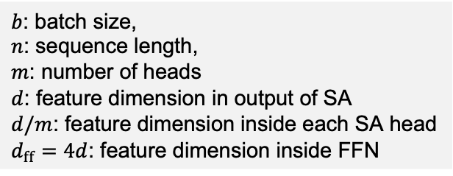
Arithmetic Intensity of Training Self-Attention
Bonus
Operation | Computations | IO | Arithmetic Intensity
${xW}_{i}^{q}$, ${xW}_{i}^{k}$, ${xW}_{i}^{v}$ for $m$ heads | $$O(bnd^{2})$$ | $$O(d^{2}+2bnd)$$ | $$O\left({\left(1/d+1/{bn}\right)}^{−1}\right)$$
$P_{i}←softmax\left(\frac{Q_{i}K_{i}^{T}}{\sqrt{d/m}}\right)$ for $m$ heads | $$O(bn^{2}d)$$ | $$O(2bnd+bmn^{2})$$ | $$O\left({\left(m/d+1/n\right)}^{−1}\right)$$
${head}_{i}←P_{i}V_{i}$ for $m$ heads | $$O(bn^{2}d)$$ | $$O(2bnd+bmn^{2})$$ | $$O\left({\left(m/d+1/n\right)}^{−1}\right)$$
$$Y=Concat\left({head}_{1}, …, {head}_{m}\right)W^{O}$$ | $$O(bnd^{2})$$ | $$O(2bnd+d^{2})$$ | $$O\left({\left(1/d+1/{bn}\right)}^{−1}\right)$$
$$Y=ReLU\left(YW_{1}\right)W_{2}$$ | $$O(16bnd^{2})$$ | $$O(2bnd+8d^{2})$$ | $$O\left({\left(1/d+1/{bn}\right)}^{−1}\right)$$
$b$: batch size,
$n$: sequence length,
$m$: number of heads
$d$: feature dimension in output of SA
$d/m$: feature dimension inside each SA head
$d_{ff}=4d$: feature dimension inside FFN
All these AI values are large! We can continue running our GPUs during training! 👍
https://le.qun.ch/en/blog/2023/05/13/transformer-batching/

Slide 40
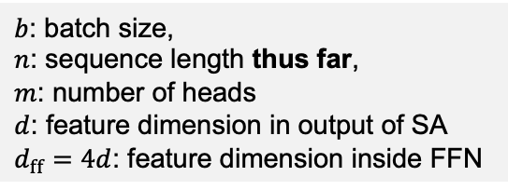
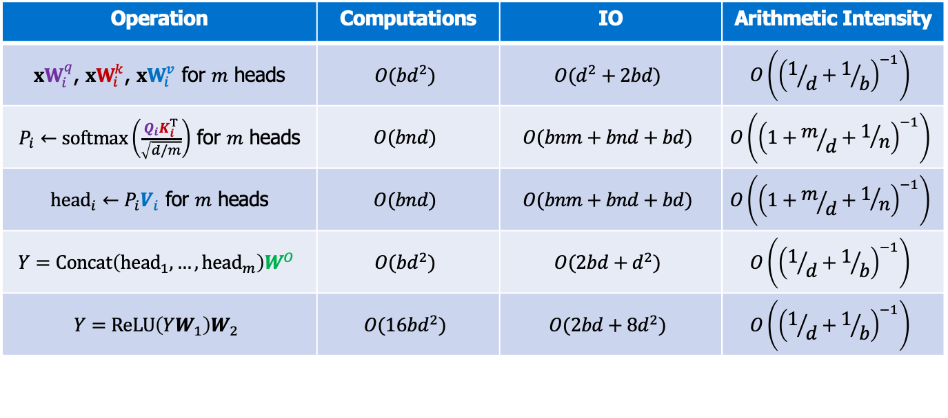
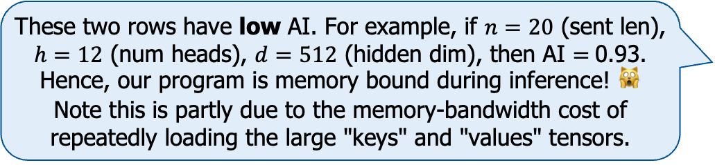
Self-Attention Cost of Computation During Incremental (Autoregressive) Generation
Bonus
Note that these numbers involve KV-caching.
Operation | Computations | IO | Arithmetic Intensity
${xW}_{i}^{q}$, ${xW}_{i}^{k}$, ${xW}_{i}^{v}$ for $m$ heads | $$O(bd^{2})$$ | $$O(d^{2}+2bd)$$ | $$O\left({\left(1/d+1/b\right)}^{−1}\right)$$
$P_{i}←softmax\left(\frac{Q_{i}K_{i}^{T}}{\sqrt{d/m}}\right)$ for $m$ heads | $$O(bnd)$$ | $$O(bnm+bnd+bd)$$ | $$O\left({\left(1+m/d+1/n\right)}^{−1}\right)$$
${head}_{i}←P_{i}V_{i}$ for $m$ heads | $$O(bnd)$$ | $$O(bnm+bnd+bd)$$ | $$O\left({\left(1+m/d+1/n\right)}^{−1}\right)$$
$$Y=Concat\left({head}_{1}, …, {head}_{m}\right)W^{O}$$ | $$O(bd^{2})$$ | $$O(2bd+d^{2})$$ | $$O\left({\left(1/d+1/b\right)}^{−1}\right)$$
$$Y=ReLU\left(YW_{1}\right)W_{2}$$ | $$O(16bd^{2})$$ | $$O(2bd+8d^{2})$$ | $$O\left({\left(1/d+1/b\right)}^{−1}\right)$$
These two rows have low AI. For example, if $n=20$ (sent len), $h=12$ (num heads), $d=512$ (hidden dim), then AI $=$0.93. Hence, our program is memory bound during inference! 🙀 Note this is partly due to the memory-bandwidth cost of repeatedly loading the large "keys" and "values" tensors.
$b$: batch size,
$n$: sequence length thus far,
$m$: number of heads
$d$: feature dimension in output of SA
$d_{ff}=4d$: feature dimension inside FFN

Slide 41
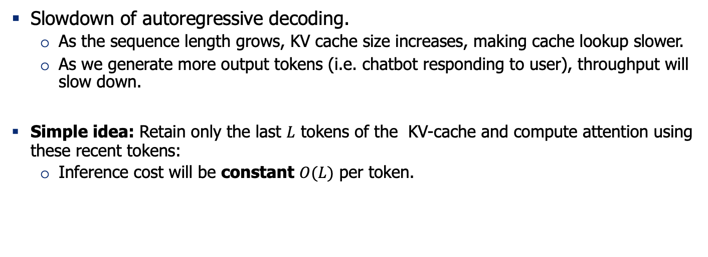
KV-Cache drag
Slowdown of autoregressive decoding.
As the sequence length grows, KV cache size increases, making cache lookup slower.
As we generate more output tokens (i.e. chatbot responding to user), throughput will slow down.
Simple idea: Retain only the last $L$ tokens of the KV-cache and compute attention using these recent tokens:
Inference cost will be constant $O(L)$ per token.

Slide 42
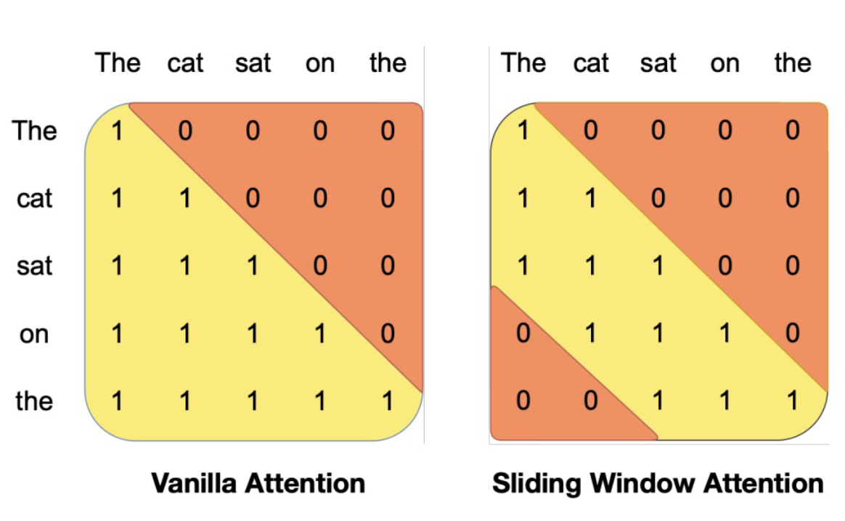
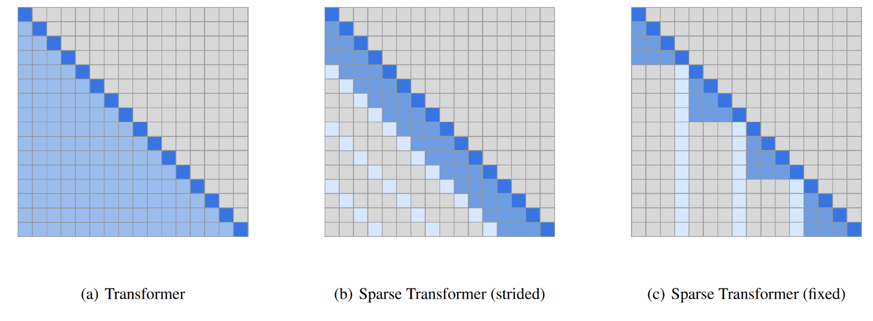
Sparse / sliding window attention
Left: Just use the main part of the strided pattern – let depth extend effective context (Mistral)
Right: Build sparse / structured attention that trades off expressiveness vs runtime.
Notable models:
GPT3 and Mistral
[Generating Long Sequences with Sparse Transformers, 2019]

Slide 43
Quiz
What are the drawbacks of sliding window?
If the model was not trained for sliding window, generation will be out-of-distribution and unstable.
If uses few layers, it’ll retains local/recent information and cannot see global context.
After a while, it will forget the input text (e.g. the original instruction provided by the user).
All of the above.
[Slide credit: Samet Oymak]

Slide 44
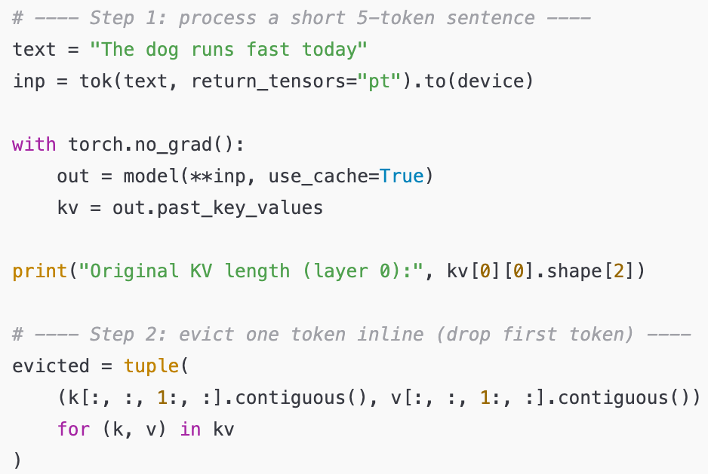
Terminology: “Eviction”
Removing old K/V pairs from the cache.
Here is a minimal example:

Slide 45
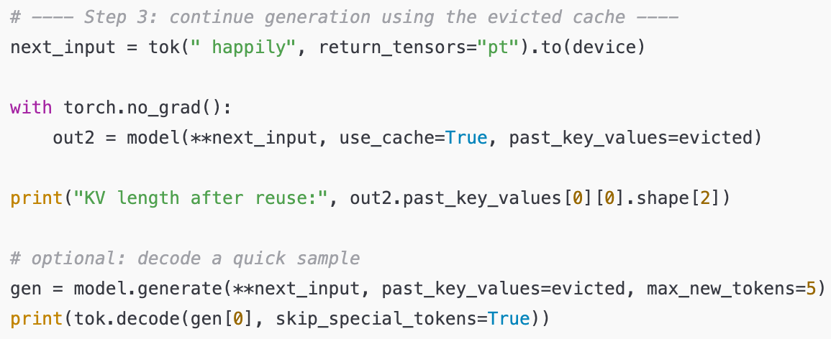
Terminology: “Eviction”

Slide 46
Examples of Last-only window
Prompt: The kid is wearing a red shirt,
Input length: 24, Output length: 49
KV Cache: unlimited -> Generated: The kid is wearing a red shirt, a blue hat, and green pants. The kid's shirt's color is red, the hat's color is blue, and the pants' color is green.
KV Cache: last_50 -> Generated: The kid is wearing a red shirt, a blue hat, and green pants. The kid's shirt's color is red. This is a picture of a kid in a red shirt, a blue hat, and green pants.
KV Cache: last_20 -> Generated: The kid is wearing a red shirt, a blue hat, and green pants. The kid's shirt's color is a red shirt's'!!!!!!!!!!!!!!!!;!!
KV Cache: last_10 -> Generated: The kid is wearing a red shirt, a blue hat, and green pants. The kid's shirt's color is is is is is's's's's's's's's'ss's }s's c, and and and
[Example credit: Sungwon Kim]

Slide 47
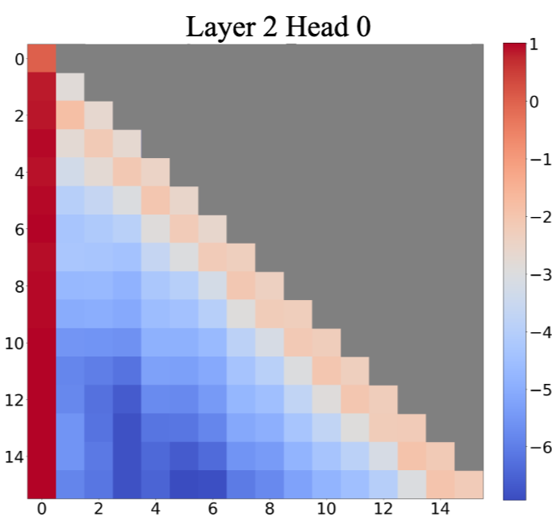
Sliding Window Attention with “Sinks”
Observations: There are few tokens (“sinks”) that the model heavily relies on.
These sink tokens (e.g., BOS) consistently receive high attention.
Removing them leads to unstable generation.
Figure: In most layers, SA heavily attends to the initial token across all heads. (the bottom two layers don’t always show this).
Why? Complicated. One explanation is, when no meaningful tokens attract attention, the model must still distribute probability mass somewhere (e.g., uninformative tokens. (note SA has to be a proper probability)
[Efficient Streaming Language Models with Attention Sinks, 2023]

Slide 48


Sliding Window Attention with “Sinks”
If you use sliding window, without retraining, your attention values will be distorted.
StreamingLLM always maintains few initial positions (sinks).
[Efficient Streaming Language Models with Attention Sinks, 2023]

Slide 49
Examples of Caching the ”sinks” (last+first)
Prompt: The kid is wearing a red shirt,
Input length: 24, Output length: 49
KV Cache: unlimited -> Generated: The kid is wearing a red shirt, a blue hat, and green pants. The kid's shirt's color is red, and the kid's hat's color is blue. The kid's pants' color is green. The kid is wearing
KV Cache: first3+last_20 -> Generated: The kid is wearing a red shirt, a blue hat, and green pants. The kid's shirt's color is red. The kid's color is red. The kid's color. The kid's red. Kid's red is. is
KV Cache: first3+last_10 -> Generated: The kid is wearing a red shirt, a blue hat, and green pants. The kid's shirt's color is a white shirt with a black and red and white and orange collar and blue and green with a black on each side of the
KV Cache: first3+last_5 -> Generated: The kid is wearing a red shirt, a blue hat, and green pants. The kid's shirt's color is the most important part of the company is the home, so as to be sure that you are on the home and you are
[Example credit: Sungwon Kim]

Slide 50
Recent variation: Native Sparse Attention
Native Sparse Attention from deepseek, which performs attention in a block level rather than in a token level. Intuitively, this means that the model learns which chunk / paragraph is important rather than which token is important.
Incorporate: https://arxiv.org/pdf/2502.11089
Native Sparse Attention: Hardware-Aligned and Natively Trainable Sparse Attention, 2025

Slide 51


Multi-Query Attention (MQA)
The idea is to reduce the memory-bandwidth cost of repeatedly loading the large "keys" and "values" tensors.
Key idea – have multiple queries, but just one dimension for keys and values.
Small PPL w/ MQA [Shazeer 2019]

Slide 52


MQA in practice
Bonus
Script

Slide 53
Grouped Query-Attention (GQA)
Notable models:
Llama 2, Mistral, Qwen2
An interpolation between “multi-head” attention and “multi-query” attention.
Simple knob to control expressiveness (key-query ratio) and inference efficiency
GQA: Training generalized multi-query transformer models from multi-head checkpoints, 2023

Slide 54


Grouped Query-Attention (GQA)
Does it actually work? Depends.
Output quality of various models; all these SA variants are on-par on quality.
Inference speed as a function of GQA group size — 8 heads gives you inference speed as good as 1 head!
GQA: Training generalized multi-query transformer models from multi-head checkpoints, 2023

Slide 55

Roofline model
Bonus
https://le.qun.ch/en/blog/2023/05/13/transformer-batching/
https://crd.lbl.gov/assets/Uploads/ECP20-Roofline-1-intro.pdf

Slide 56
Recap
SA’s AI during inference is not good.
We’re doing a lot of IO relative to computations (KV drag).
Sliding window attention: sparsifying attention pattern by looking at nearby things.
MQA and GQA: sharing attention keys and values.

Slide 57
Do you the dimensions of my latent embeddings?

Slide 58

Low-Rank Key-Value Joint Compression
Joint compress (project) keys and values to reduce KV cache:
DeepSeek-V2: A Strong, Economical, and Efficient Mixture-of-Experts Language Mode, 2024

Slide 59


Low-Rank Key-Value Joint Compression
Joint compress (project) keys and values to reduce KV cache:
DeepSeek-V2: A Strong, Economical, and Efficient Mixture-of-Experts Language Mode, 2024

Slide 60

MLA: KV-Cache size comparison
MLA’s KV cache size is equal to GQA with only 2.25 groups. How about its performance? (vs. MHA and GQA)
DeepSeek-V2: A Strong, Economical, and Efficient Mixture-of-Experts Language Mode, 2024

Slide 61

MLA: KV-Cache size comparison
MLA (DeepSeek-V2) shows better performance than MHA, but requires a significantly smaller amount of KV cache.
DeepSeek-V2: A Strong, Economical, and Efficient Mixture-of-Experts Language Mode, 2024

Slide 62
Prefix Caching
(or, prompt caching)

Slide 63
Prefix Caching
Many prompts (e.g., from different users) share the same prefix.
<System> You are a helpful assistant … <System>
<User> I want to know how can I use the coffee machine <User>
<System> You are a helpful assistant … <System>
<User> Write the code for training my language model. <User>
<System> You are a helpful assistant … <System>
<User> Help me revise my email ... <User>

Slide 64
Prefix Caching
Prefix caching means reusing the KV cache from a shared prefix of tokens across multiple inference runs or generations, instead of recomputing it.
Most libraries (e.g., vLLM) have this feature implemented:
enable_prefix_caching=True
<System> You are a helpful assistant … <System>
Prefix Cache
CPU or GPU
But, can we slice the activations to fit them in different GPUs?
- Yes, by Tensor Parallelism

Slide 65
Distributed Training

Slide 66
Motivation
How much GPU memory (at least) do we need to perform inference/training?
(batch size=1, ignoring the KV cache and optimizer states)
Model Size (Llama 3 architecture) | Inference Memory (~2x model size) | Training Memory (~7x model size)
8B | 16GB | 60GB
70B | 140GB | 500GB
405B | 810GB | 3.25TB
Source: https://huggingface.co/blog/llama31#inference-memory-requirements

Slide 67

Where did all the memory go?
Longer sequences require much more memory in training!
Training Sequence Length (Number of Tokens)
Source: https://nanotron-ultrascale-playbook.static.hf.space/dist/index.html

Slide 68
Model Efficiency: Topics
Distributed Training
Quantization (Post Training Quantization)
Distillation
Chapter goal: Getting comfortable with various mathematical and systems foundations for efficient deployment of LLMs.

Slide 69


Distributed Training
Naïve Data Parallelism
Sharding Optimizer States (ZeRO, FSDP)
Model Parallelism (Tensor Parallelism, Pipeline Parallelism)
GPU 0
Model Copy
GPU 2
Model Copy
GPU 3
Model Copy

Slide 70
Brief on GPU Operations for Communicating Tensors

Slide 71

NCCL: NVIDIA Collective Communication Library
Pronounced "Nickel”!!
NCCL provides routines to send and receive information within NVIDIA GPUs.
NCCL provides the following collective communication primitives :
AllReduce
Broadcast
Reduce
AllGather
ReduceScatter
AlltoAll
Gather
Scatter
Documentation: https://docs.nvidia.com/deeplearning/nccl/user-guide/docs/overview.html#
Github: https://github.com/NVIDIA/nccl

Slide 72

NCCL: NVIDIA Collective Communication Library

Slide 73

NCCL Operations: Reduce
Nvidia Collective Communications Library (NCCL) - A library developed to provide inter-GPU communications primitives (operations)
Reduce: *Sums* over all *tensors* and stores it in a root GPU
NCCL (NVIDIA Collective Communication Library): NVIDIA’s high-performance library for multi-GPU and multi-node communication: https://docs.nvidia.com/deeplearning/nccl/user-guide/docs/usage/collectives.html

Slide 74

NCCL Operations: Broadcast
Broadcast: Duplicates one tensor to all GPUs

Slide 75

NCCL Operations: All Reduce
All Reduce = Reduce + Broadcast
= Sum over input tensors, then duplicate it to all GPUs

Slide 76
Incorporate: More on NCCL operations
I may want to have a brief introduction on these before I get to distributed training: https://www.youtube.com/watch?v=T22e3fgit-A

Slide 77
Back to distributed training!

Slide 78

Naïve Data Parallelism
Dataset
GPU 0
Model Copy
GPU 1
Model Copy
GPU 2
Model Copy
First, we want to shard the dataset and feed them into different GPUs
How do we update the parameters?

Slide 79
Naïve Data Parallelism
Each GPU compute gradient with a single shard of data
Gradient 1
Gradient 2
Gradient 3
GPU 1
Model Copy
GPU 2
Model Copy
GPU 3
Model Copy

Slide 80
Naïve Data Parallelism
Gradient 3
One GPU accumulates the gradients
(reduce in torch.distributed)
Gradient 2
Gradient 1
GPU 1
Model Copy
GPU 2
Model Copy
GPU 3
Model Copy
https://docs.pytorch.org/docs/stable/distributed.html

Slide 81
Naïve Data Parallelism
And send the accumulated gradient to all other GPUs (broadcast in torch.distributed)
Gradient 3
Gradient 3
Gradient 3
Gradient 2
Gradient 2
Gradient 2
Gradient 1
Gradient 1
Gradient 1
GPU 1
Model Copy
GPU 2
Model Copy
GPU 3
Model Copy

Slide 82
Naïve Data Parallelism
Accumulate gradients across all GPUs and perform gradient updates
（all_reduce in torch.distributed）
Gradient 3
Gradient 3
Gradient 3
Gradient 2
Gradient 2
Gradient 2
Gradient 1
Gradient 1
Gradient 1
GPU 1
Model Copy
GPU 2
Model Copy
GPU 3
Model Copy

Slide 83
What is wrong with Naïve DP
In naïve DP, each GPU holds a full copy of everything related to training — not just the model parameters.
GPU 1
Model Copy
Component | Precision | Bytes per param | Purpose
Model parameters | FP16/BF16 | 2 | The half-precision weights used in forward/backward passes
Gradients | FP16/BF16 | 2 | The half-precision gradients computed during backprop
Master weights | FP32 | 4 | Full-precision version used for stable updates in mixed-precision training
Adam first moment (m) | FP32 | 4 | Tracks running average of gradients
Adam second moment (v) | FP32 | 4 | Tracks running average of squared gradients
For each parameter, you actually need five versions, which together take 16 bytes per parameter!
That’s why naïve DP quickly runs out of memory as model size grows
Memory/GPU for a 7.5B model:
7.5B * 16 bytes = 120 GB!

Slide 84

What is wrong with Naïve DP

Slide 85
Naïve DP: Summary
Each GPU holds a full copy of the model. The training data is split into batches distributed across GPUs; each computes gradients locally, then gradients are averaged (e.g., via all-reduce) before updating model parameters.
Pros: Simple, widely supported.
Cons: Model parameters and optimizer states are fully replicated → high memory cost, limiting scalability.
Stage | What’s Sharded | Approx bytes / param | Memory / GPU (7.5 B params)
Naïve DP | None | 16 B | 120 GB

Slide 86

Naïve DP – Requires too much memory!
ZeRO: Memory Optimizations Toward Training Trillion Parameter Models (Rajbhandari et al., 2019)

Slide 87
ZeRO: Sharding Optimizer States
ZeRO (Zero Redundancy Optimizer) reduces memory use in distributed training by sharding model states across GPUs instead of replicating them.
Stage 1: shard optimizer states
Stage 2: + shard gradients
Stage 3: + shard model parameters
Result: Dramatically reduced memory use. Integrated to DeepSpeed and PyTorch FSDP.
Note: “Stage x” means a variant, not a step!
Stage | What’s Sharded | Approx bytes / param | Memory / GPU (7.5 B params)
Naïve DP | None | 16 B | 120 GB
ZeRO-1 | Optimizer states | ≈ 6–7 B | 50 GB
ZeRO-2 | + Gradients | ≈ 5 B | 40 GB
ZeRO-3 | + Parameters | ≈ 2 B | 15 GB
ZeRO: Memory Optimizations Toward Training Trillion Parameter Models (Rajbhandari et al., 2019)

Slide 88
More on GPU Operations for Communicating Tensors

Slide 89
Quick pulse check
Four GPUs (GPU₀–GPU₃) each start with values [2, 4, 6, 8].
After a Reduce (sum) to GPU₀, what are the final values on all GPUs?
GPU₀: 20
GPU₁–GPU₃: unchanged / discarded (they don’t receive the result).

Slide 90
Quick pulse check (2)
GPU₀ starts with 5, and GPUs ₁–₃ hold [1, 2, 3].
After a Broadcast from GPU₀, what are the final values on all GPUs?
GPU₀–GPU₃: [5, 5, 5, 5]

Slide 91
Quick pulse check (3)
Four GPUs (GPU₀–GPU₃) each start with [2, 4, 6, 8].
After an All-Reduce (sum), what are the final values on all GPUs?
GPU₀–GPU₃: [20, 20, 20, 20]

Slide 92

NCCL Operations: Scatter
Split a tensor into chunks and send one chunk to each GPU.

Slide 93

Broadcast vs Scatter

Slide 94

NCCL Operations: Reduce Scatter
Each GPU stores the sum of a shard of the input.

Slide 95

NCCL Operations: Gather
Gather is the opposite of Scatter.
Collect chunks of data from multiple GPUs and assemble them into one larger tensor on a single GPU (or all GPUs, depending on the variant).

Slide 96
Diversion: Gather vs Reduce

Slide 97

Quiz: NCCL Operations: All Gather
Everyone sends their piece → everyone receives the full set.
Every GPU performs a ___?___ operation in parallel.
A.Reduce B. Broadcast C. Reduce_scatter

Slide 98
NCCL Operations: All Gather
Everyone sends their piece → everyone receives the full set.
Every GPU performs a ___broadcast___ operation in parallel.
A.Reduce B. Broadcast C. Reduce_scatter

Slide 99
Back to ZeRO!

Slide 100
ZeRO Stage 1: Sharding Optimizer States
Only optimizer states are partitioned (sharded) among GPUs:
Each GPU keeps just 1/N of the optimizer states, where N is the number of GPUs.
Model parameters and gradients are still fully replicated (as in naïve DP).
When it’s time to update parameters, GPUs communicate to access the parts of the optimizer state they need, apply updates, and synchronize the results.
ZeRO: Memory Optimizations Toward Training Trillion Parameter Models (Rajbhandari et al., 2019)

Slide 101

ZeRO Stage 1: Sharding Optimizer States
ZeRO: Memory Optimizations Toward Training Trillion Parameter Models (Rajbhandari et al., 2019)

Slide 102
ZeRO Stage 1: How it works
Update Parameters
Each GPU compute gradient with a single shard of data
(The same as naïve DP)
Gradient 1
Gradient 2
Gradient 3
GPU 1
Model Copy
GPU 2
Model Copy
GPU 3
Model Copy
ZeRO: Memory Optimizations Toward Training Trillion Parameter Models (Rajbhandari et al., 2019)

Slide 103
ZeRO Stage 1: How it works
Assuming that
GPU1 stores optimizer states for parameters A,
GPU2 stores optimizer states for params B,
GPU3 stores optimizer states for params C
Gradient 1
Gradient 2
Gradient 3
A
B
C
GPU 1
Model Copy
GPU 2
Model Copy
GPU 3
Model Copy
ZeRO: Memory Optimizations Toward Training Trillion Parameter Models (Rajbhandari et al., 2019)

Slide 104
ZeRO Stage 1: How it works
Split / shard the optimizer states into 3 parts!
A
B
C
A
B
C
A
B
C
Gradient 1
Gradient 2
Gradient 3
A
B
C
GPU 1
Model Copy
GPU 2
Model Copy
GPU 3
Model Copy
ZeRO: Memory Optimizations Toward Training Trillion Parameter Models (Rajbhandari et al., 2019)

Slide 105
ZeRO Stage 1: How it works
Each GPU accumulates gradients of the params whose optimizer states the GPU is storing (reduce_scatter in torch.distributed)
A
B
C
A
B
C
A
B
C
Gradient 1
Gradient 2
Gradient 3
A
B
C
GPU 1
Model Copy
GPU 2
Model Copy
GPU 3
Model Copy
ZeRO: Memory Optimizations Toward Training Trillion Parameter Models (Rajbhandari et al., 2019)

Slide 106
ZeRO Stage 1: How it works
GPU1 : update params A;
GPU2: Updates Params B;
GPU3: updates params C.
GPU1 can only update params A since it only stores optimizer states of params A.
Updated A
Updated B
Updated C
Gradient 1
Gradient 2
Gradient 3
A
B
C
GPU 1
Model Copy
GPU 2
Model Copy
GPU 3
Model Copy
ZeRO: Memory Optimizations Toward Training Trillion Parameter Models (Rajbhandari et al., 2019)

Slide 107
ZeRO Stage 1: How it works
Each GPU sends updated params to every other GPU. Finishing optimizer.step(). (all_gather in torch.distributed)
After all_gather, every GPU has an updated copy of the model
Updated A
Updated A
Updated A
Updated B
Updated B
Updated B
Updated C
Updated C
Updated C
Gradient 1
Gradient 2
Gradient 3
GPU 1
Model Copy
GPU 2
Model Copy
GPU 3
Model Copy
ZeRO: Memory Optimizations Toward Training Trillion Parameter Models (Rajbhandari et al., 2019)

Slide 108
How expensive are the communications?
During the forward and backward passes, no extra communication is needed; GPUs operate independently.
Only the optimizer states are sharded — and they’re used infrequently (once per parameter update).
Communication happens only at the update step, when each GPU briefly exchanges the small portions of optimizer state it owns to apply updates.

Slide 109

Inter-GPU Communication (inter-node vs intra-node)
The numbers are GB/s

Slide 110
Summary: ZeRO 1
It shards only the optimizer states (e.g., Adam’s m, v) across GPUs.
While model parameters and gradients remain fully replicated.
Each GPU individually perform gradient updates
This removes redundant copies of the heaviest memory component, giving roughly a 1 / N reduction in optimizer-state memory (for N GPUs) with minimal-ish communication overhead.
Basically free! (Compared to Naïve Data Parallelism)

Slide 111
ZeRO Stage 1: How it works
Notice: Aside from the forward pass, GPU 1 only needs gradients A, but in fact it stores A and B and C
A
You only need these
A
A
Gradient 1
Hey GPU1, you don't need this (can be large)
GPU 1
Model Copy
GPU 2
Model Copy
GPU 3
Model Copy
ZeRO: Memory Optimizations Toward Training Trillion Parameter Models (Rajbhandari et al., 2019)

Slide 112

ZeRO Stage 2: Sharding Gradients
ZeRO: Memory Optimizations Toward Training Trillion Parameter Models (Rajbhandari et al., 2019)

Slide 113
ZeRO Stage 2: How it works
Model params are replicated. But we’re going to shard gradients + optimizer states.
Forward pass: Each GPU holds a full copy of the model parameters (as in Stage 1). No extra communication happens here.
Forward activations
Forward activations
Forward activations
GPU 1
Model Copy
GPU 2
Model Copy
GPU 3
Model Copy
ZeRO: Memory Optimizations Toward Training Trillion Parameter Models (Rajbhandari et al., 2019)

Slide 114
ZeRO Stage 2: How it works
Backward pass:
Each GPU computes gradients for its local batch.
Instead of storing all gradients, each GPU keeps only its shard of the gradient.
As soon as the gradients of layer X are computed during backprop, shard them across GPUs.
This uses reduce-scatter operation.
A
B
C
A
B
C
A
B
C
Gradient of layer X
Gradient of layer X
Gradient of layer X
GPU 1
Model Copy
GPU 2
Model Copy
GPU 3
Model Copy
ZeRO: Memory Optimizations Toward Training Trillion Parameter Models (Rajbhandari et al., 2019)

Slide 115
ZeRO Stage 2: How it works
Backward pass:
Each GPU computes gradients for its local batch.
Instead of storing all gradients, each GPU keeps only its shard of the gradient.
As soon as the gradients of layer X are computed during backprop, shard them across GPUs.
This uses reduce-scatter operation incrementally during backpropagation, layer by layer, rather than all at once.
A
A
A
B
B
B
C
C
C
Gradient of layer X
Gradient of layer X
Gradient of layer X
GPU 1
Model Copy
GPU 2
Model Copy
GPU 3
Model Copy
ZeRO: Memory Optimizations Toward Training Trillion Parameter Models (Rajbhandari et al., 2019)

Slide 116
ZeRO Stage 2: How it works
Optimizer step:
It updates only its own parameter using its shard of grads + optimizer states.
Params A
Params A
Params A
Params B
Params B
Params B
Params C
Params C
Params C
A
A
A
B
B
B
C
C
C
Gradient of layer X
Gradient of layer X
Gradient of layer X
GPU 1
Model Copy
GPU 2
Model Copy
GPU 3
Model Copy
ZeRO: Memory Optimizations Toward Training Trillion Parameter Models (Rajbhandari et al., 2019)

Slide 117
ZeRO Stage 2: How it works
Optimizer step:
It updates only its own parameter using its shard of grads + optimizer states.
Params A
Params A
Params A
Params B
Params B
Params B
Params C
Params C
Params C
A
A
A
B
B
B
C
C
C
Gradient of layer X
Gradient of layer X
Gradient of layer X
GPU 1
Model Copy
GPU 2
Model Copy
GPU 3
Model Copy
ZeRO: Memory Optimizations Toward Training Trillion Parameter Models (Rajbhandari et al., 2019)

Slide 118
ZeRO Stage 2: How it works
Optimizer step:
It updates only its own parameter using its shard of grads + optimizer states.
Parameters are still replicated, so updates must be broadcast after each step to keep all GPUs in sync. (done with all-gather)
Params A
Params A
Params A
Params B
Params B
Params B
Params C
Params C
Params C
A
A
A
B
B
B
C
C
C
Gradient of layer X
Gradient of layer X
Gradient of layer X
GPU 1
Model Copy
GPU 2
Model Copy
GPU 3
Model Copy
ZeRO: Memory Optimizations Toward Training Trillion Parameter Models (Rajbhandari et al., 2019)

Slide 119
Summary: ZeRO Stage 2
Builds on Stage 1 by sharding gradients in addition to optimizer states.
Memory savings: no duplicate gradients or optimizer states.
Trade-off: slightly higher communication overhead each step.
Communication is not bad since it’s amortized!!
Stage | What’s Sharded | Approx bytes / param | Memory / GPU (7.5 B params)
Naïve DP | None | 16 B | 120 GB
ZeRO-1 | Optimizer states | ≈ 6–7 B | 50 GB
ZeRO-2 | + Gradients | ≈ 5 B | 40 GB

Slide 120

ZeRO-3 (aka FSDP): Shard Everything!
ZeRO: Memory Optimizations Toward Training Trillion Parameter Models (Rajbhandari et al., 2019)

Slide 121
ZeRO Stage 3: How it works (simplified)
Each GPU stores only its shard of:
Model parameters
Gradients
Optimizer states
When a layer is needed for computation, its parameters are All-Gathered from all GPUs just in time.
After computing gradients, those gradients are Reduce-Scattered back to distribute and free memory.
Optimizer updates are done locally on each shard.

Slide 122

ZeRO Stage 3: How it works (simplified)
When a layer is needed for computation, its parameters are All-Gathered from all GPUs just in time.

Slide 123

ZeRO Stage 3: How it works (simplified)
After computing gradients, those gradients are Reduce-Scattered back to distribute and free memory.

Slide 124
Zero3 Recap
Shards everything — parameters, gradients, and optimizer states — across GPUs.
Provides maximum memory savings (~1/N per GPU), enabling extremely large models.
Comes with higher communication cost, since parameters must be gathered repeatedly during training.

Slide 125
Communication Costs
Naïve Data Parallel: 2x parameter (all_reduce)
ZeRO-1: ~1x parameter (reduce_scatter + all_gather) - this is free! Might as well always use it.
ZeRO-2: 2x parameter (reduce_scatter + all_gather + overhead) - this is (almost) free! (the communication is amortized)
ZeRO-3: ~3x parameter – which can be quite slow.

Slide 126
Q: Where do we store the KV Cache?
Depends.
If you’re doing single-GPU inference, it sits on the GPU that computes attention.
KV cache can be offloaded to CPU (RAM) (if GPU is running out of space) but adds latency.
Data Parallel (incl. ZeRO): Each rank keeps the full KV for the sequences it’s serving (belongs to activations, not optimizer/params). Activation checkpointing can trade KV memory for recompute; ZeRO doesn’t shard KV.
Tensor Parallel (TP): KV is sharded across TP ranks (each rank holds the slice of K/V that corresponds to its tensor partition). Collective reads happen implicitly during attention matmuls.
Pipeline Parallel (PP): Each pipeline stage stores KV only for its own layers.

Slide 127

Memory consumption is not static
During backward, activation memory gets freed, gradients gets more memory
During the forward step, the activations occupy most of the memory
Source: https://nanotron-ultrascale-playbook.static.hf.space/dist/index.html

Slide 128
Where did all the memory go?
So far, we dealt with the optimizer states
but what about the activations?
Training Sequence Length (Number of Tokens)
Source: https://nanotron-ultrascale-playbook.static.hf.space/dist/index.html

Slide 129

Tensor Parallelism
We can either cut the weights W into two columns (Column Parallelism)
or into two rows (Row Parallelism)

Slide 130

Column-wise Tensor Parallelism
Cuts the weight matrix W into 2
columns
Source: https://nanotron-ultrascale-playbook.static.hf.space/dist/index.html

Slide 131

Row-wise Tensor Parallelism
Cuts the weight matrix W into 2
rows
Source: https://nanotron-ultrascale-playbook.static.hf.space/dist/index.html

Slide 132

Tensor Parallelism
Computing matrix multiplications without storing internal activations (e.g. xW1)
In Feed-Forward Networks,
The dimension of
W1 is usually 4x the hidden dimension.
W1
W2
X
Y

Slide 133

Tensor Parallelism: Llama Feed-Forward
activations are element-wise operations, can be parallelized
Source: https://github.com/meta-llama/llama/blob/main/llama/model.py

Slide 134


Tensor Parallelism: Llama Attention
Column Parallel for Query, Key and Vector
and Row Parallel for attention output
Source: https://github.com/meta-llama/llama/blob/main/llama/model.py

Slide 135
Summary so far
Data Parallelism
Naïve Data Parallelism
NCCL Operations
(reduce, all_reduce, reduce_scatter, broadcast, all_gather)
ZeRO-1, ZeRO-2, ZeRO-3
Prefix Caching
Tensor Parallelism
Row-wise Tensor Parallelism
Column-wise Tensor Parallelism

Slide 136

Tensor Parallelism
Source: https://github.com/meta-llama/llama/blob/main/llama/model.py

Slide 137

Throughput Scaling of Tensor Parallelism
A large drop in throughput when scaling beyond 8 GPUs (one node)
Source: https://nanotron-ultrascale-playbook.static.hf.space/dist/index.html

Slide 138

Throughput Scaling of Tensor Parallelism
Throughput drops significantly once we go beyond one node!
Source: https://nanotron-ultrascale-playbook.static.hf.space/dist/index.html

Slide 139

Pipeline Parallelism
Shard each layer of the model into individual GPUs:
Prevents the cost of syncing params
Credit: Song Han (MIT)

Slide 140


Pipeline Parallelism
Each GPU is only working for 1/PP = ¼ of the time!
Idle/Work ratio = pp – 1 = 3
GPipe: Easy Scaling with Micro-Batch Pipeline Parallelism (Huang et al., NeurIPS 2019)

Slide 141

Pipeline Parallelism: Improvement
Solution: Splitting the data into mini-batches! (AFAB)
Idle / Work Ratio = PP-1 / M= 3 / 4
GPipe: Easy Scaling with Micro-Batch Pipeline Parallelism (Huang et al., NeurIPS 2019)

Slide 142

Pipeline Parallelism
A cleverer version of AFAB: 1 Forward 1 Backward (1F1B)
Idea: Do backward as early as possible, releasing activations on the fly
Roughly the same Idle/Work Ratio but less memory
(as you only need to store p=4 activations rather than m=8)
GPipe: Easy Scaling with Micro-Batch Pipeline Parallelism (Huang et al., NeurIPS 2019)

Slide 143

Pipeline Parallelism Throughput
A small drop in throughput when scaling beyond 8 GPUs (one node)
but a large drop as we increase the microbatch number

Slide 144

Interleaving Pipeline Parallelism (LLama3)

Slide 145

Interleaved Pipeline Parallelism (DeepSeek)
backprop for weights (blue) can be computed at any time!
We fill in the bubble with weight back propagation.

Slide 146
What about (super) long sequences?
Suppose we want to split the sequence into different GPUs
This is a super long sequence of text.
This is
a super long
sequence of text
GPU 1
Model Copy
GPU 2
Model Copy
GPU 3
Model Copy

Slide 147
What about (super) long sequences?
Feed Forward Network / LayerNorm is not affected by splitting the sequence, each token is processed individually
But what about attention? Each token needs to compute dot product with every other token.

Slide 148

Context Parallelism (Ring Attention)
Just pass the Key, Value pairs around!
However, attention mask is usually causal – Q1 does not need K2, V2, ...
Source: Ring Attention with Blockwise Transformers For Near-Infinite Context (Liu et al., 2023)

Slide 149

Context Parallelism (Ring Attention)
GPU 1 computes the pre-softmax-ed scores for
Q1, Q2, Q3, Q4.. then becomes idle.
Source: Ring Attention with Blockwise Transformers For Near-Infinite Context (Liu et al., 2023)

Slide 150

Context Parallelism (Ring Attention)
Balancing the workload for each individual GPUs.
Source: Striped Attention: Faster Ring Attention for Causal Transformers (Brandon et al., 2023)

Slide 151

Context Parallelism (Ring Attention)
Source: https://nanotron-ultrascale-playbook.static.hf.space/dist/index.html

Slide 152

Summarizing
Source: Tatsunori Hashimoto (Stanford)

Slide 153


Solutions
DeepSeek V3: DP=1, PP=16*8, EP (Expert Parallelism) = 64
Llama 3: Staged Training

Slide 154
Quantization

Slide 155

Quantization: Mapping from high to low precision

Slide 156

Numeric Data Types
Example: 32-bit floating point number in IEEE 754 (FP32)

Slide 157

Floating Point Numbers

Slide 158

Floating Point Numbers
More range, less precision

Slide 159

Linear Quantization
How to find these numbers?​

Slide 160

Linear Quantization

Slide 161

Linear Quantization: Scale
Quantization and Training of Neural Networks for Efficient Integer-Arithmetic-Only Inference (Jacob et al., CVPR 2018)

Slide 162


Linear Quantization: Zero Point
Quantization and Training of Neural Networks for Efficient Integer-Arithmetic-Only Inference (Jacob et al., CVPR 2018)

Slide 163

Linear Quantization: Zero Point
Quantization and Training of Neural Networks for Efficient Integer-Arithmetic-Only Inference (Jacob et al., CVPR 2018)

Slide 164

Quantization of Language Models
There exists many outliers in activations (activations of the first layer MobileNetV2):
Data-Free Quantization Through Weight Equalization and Bias Correction (Kagel et al., ICCV 2019)

Slide 165

Quantization of Language Models
Data-Free Quantization Through Weight Equalization and Bias Correction (Kagel et al., ICCV 2019)

Slide 166
Quantization of Language Models
Quantize each channel individually, each channel gets its own scale and Zero-point!
Data-Free Quantization Through Weight Equalization and Bias Correction (Kagel et al., ICCV 2019)

Slide 167

Quantization of Language Models
Outlier features significantly harms performance after quantization in LMs.
LLM.int8(): 8-bit Matrix Multiplication for Transformers at Scale (Dettmers et al., NeurIPS 2022)

Slide 168

Quantization of Language Models
Outlier features significantly harms performance after quantization in LMs.
LLM.int8(): 8-bit Matrix Multiplication for Transformers at Scale (Dettmers et al., NeurIPS 2022)

Slide 169

Quantization of Language Models
Keep outlier channels / features in 16-bit, quantize the rest.
LLM.int8(): 8-bit Matrix Multiplication for Transformers at Scale (Dettmers et al., NeurIPS 2022)

Slide 170

Quantization of Language Models
Zeropoint > absmax because outliers non-symmetric (either very large or very small, but not both)
LLM.int8(): 8-bit Matrix Multiplication for Transformers at Scale (Dettmers et al., NeurIPS 2022)

Slide 171
Quantization of Language Models
Maps floating point numbers (fp32, fp16, bf16) to low precision numbers (fp8, int8) to save memory.
Is effective in reducing the memory required for both training / inference.
8-bit quantization loses minimal performance, while 4-bit quantization is hard, can be harmful to model performance.

Slide 172
Distilling the knowledge of larger models

Slide 173

Distillation
Knowledge and/or capabilities of a larger model
small model

Slide 174

Revisit: Standard Training (NLLloss)
prefix: The strange case ___
groundtruth: of
Loss = -log p(of)
= Cross Entropy(y_pred, groundtruth)

Slide 175
Revisit: Standard Training (NLLloss)
prefix: The strange case ___
groundtruth: of
loss = -log p(of)

Slide 176

Revisit: Standard Training (NLLloss)
loss = -log p(of) = Cross Entropy(groundtruth, y_pred)
Groundtruth
(one-hot)
y_pred

Slide 177

Knowledge Distillation
KD loss = Cross Entropy(y_large, y_pred)
Large model next token probs (y_large)
small model next token probs
(y_pred)

Slide 178

Knowledge Distillation
Step 1: Initialize teacher model with a large and capable model
Step 2: Feed input data to both student and teacher (freezed)
Step 3: Use teacher outputs to train student (Cross Entropy)

Slide 179
What if the teacher is Proprietary (GPT)?
Step 1: Initialize teacher model with a large and capable model
Step 2: Feed input data to both student and teacher (freezed)
Step 3: Use teacher generations (instead of outputs) to train student!

Slide 180
Revisit: Standard Training (NLLloss)
loss = -log p(of) = Cross Entropy(sampled text, y_pred)
Sampled output
(one-hot)
y_pred

Slide 181

What works better (a study in 2016)
Use teacher log-probs
Use teacher generations
Sequence-Level Knowledge Distillation (Kim & Rush, EMNLP 2016)

Slide 182
Knowledge Distillation
Train student (usually smaller model) on the output of a teacher (usually a larger model)
The output can be log-probabilities or sampled outputs
Effective in "distilling" the knowledge of large models to smaller ones.

Slide 183
https://www.tensoreconomics.com/p/llm-inference-economics-from-first?utm_source=substack&utm_medium=email

Slide 184
VERY GOOD: Incorporate
https://arxiv.org/pdf/2502.17129
Here are some topics:
– KV cache optimization
- memory management
-

